Slide 1
On the way to seamless mobility
integration and interoperability
of fare collection systems
ALAMYS XXVIII GENERAL Assembly, Mexico City,
12:30 Monday 8 December 2014

Slide 2
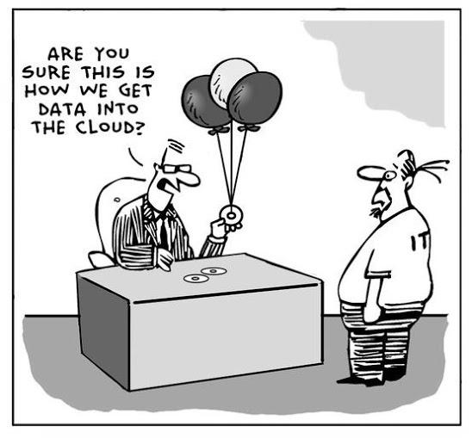
UITP
international association of public transport
UITP manager - IT solutions in public transport
a helicopter overview of IT developments
staying connected to changed lifestyles
smart traveler + intelligent communities
main topics
information – open data
ticketing – EMV, NFC, ISO
third parties – apps, business
smart … – cities, data, services
(cyber security, privacy, etc…)
(ITCS, fleet management, APC, etc…)

Slide 3

message
clear from the start – open for debate…
For the sake of your (potential) customers:
try INTEGRATION first
and INTEROPERABILITY as a last resort
Disclaimer: “increased comfort for the client likely increases complexity for you!”

Slide 4
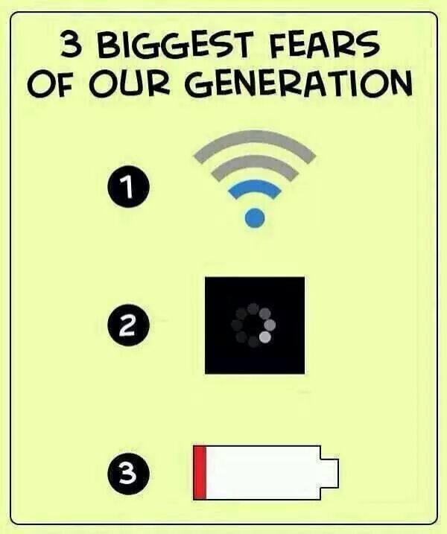
Challenges
1
big
bigger
biggest

Slide 5

Seamless mobility
mobility without barriers – our big challenge
customers’ barriers
connections
information
ticketing
payment
sector’s barriers
inter-modal
multi-modal
co-modal
cross-border
multi-operator
not one size fits all
competition
cross-border
(far away) neigbours
inter-/multi-/co-
modality
multi-operator
in time and place
environment

Slide 6



technology
technology is never the real challenge!
bigger challenges
traditional
political
financial
organisational
our needs
balance between interoperability and subsidiarity
act as a global player
accept help from 3rd parties
biggest challenge
keeping in sync with changed lifestyles of the
smart travelers in their intelligent communities

Slide 7
Integration & interoperability
2
or
organisational integration
versus
technical interoperability

Slide 8

strive for quality
prefer integration over interoperability
What is possibly better (for the customer), examples:
separate or integrated timetables
through services or transfers
2 tickets or 1 ticket
one stop shop or…
Technology can help, to a certain extent:
integration vs. interoperability
bottom-up vs. top-down
open architecture vs. proprietary
A good mix:
magic black boxes
defined interfaces
standards and specifications
technical interoperability
organisational integration

Slide 9
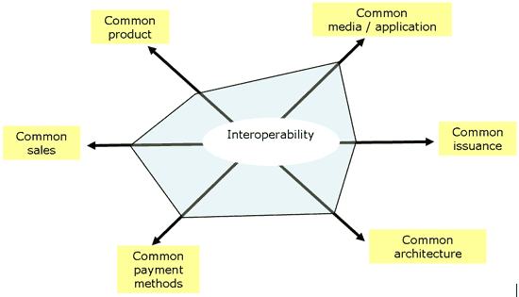
How much, please?
there are many areas of potential incompatibility

Slide 10

PAYMENT ≠ ticketing
ticketing is not as simple as payment
Distinction
payment = payment – paying the bill!
ticketing = payment + a contract (and give proof)
Example
fare box = payment – pay a dollar and travel
ticketing = free travel, concessionary fares, capped and reduced prices, time or space based, and combinations.
Electronic ticketing is not much different from “paper” ticketing!
Revenue clearing, multi bilateral contracts, fraud, risk, open/closed

Slide 11
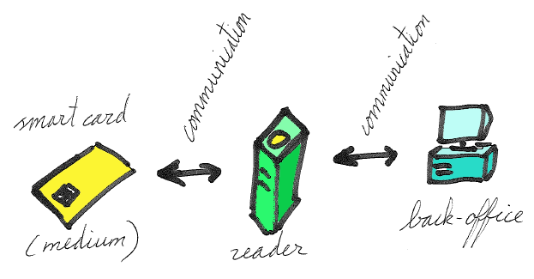
Basic Ticketing
user medium <> media accepting devices <> back offices
customer spends money to buy products to put on a medium
revenue clearing
allow in?
must work offline – handshake + data transaction
300 ms < transaction time < 400 ms
<<< end 2 end security using secret keys and encryption >>>
level of security depends on accepted risk

Slide 12

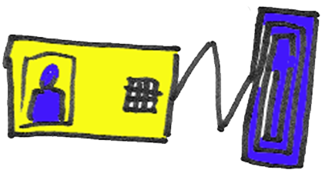
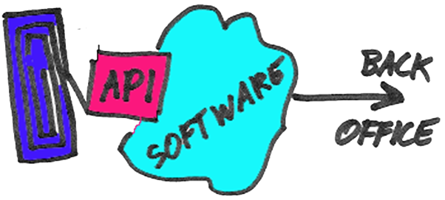
Basic Ticketing
contactless communication
if customer medium can be anything…
and if media accepting device (MAD) can be anything…
…then ay least the contactless interface needs to be defined.
you decide who is allowed in
MAD’s could possibly communicate by multiple standards

Slide 13
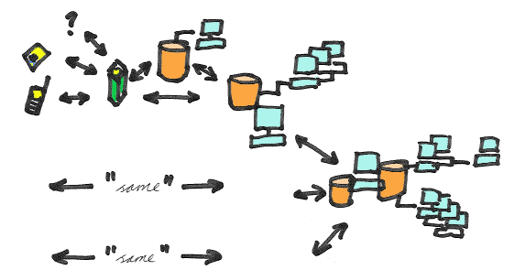
Basic Ticketing
operator, local, regional, national, (international?)
Maybe think big(ger)…
But always think ahead, and thoroughly (the devil is in the details)
EXAMPLE: OV-Chipkaart in the Netherlands

Slide 14
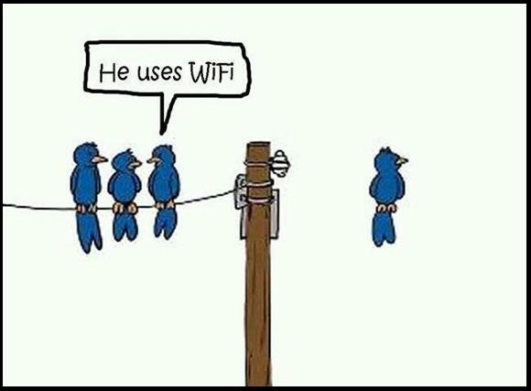
Ticketing add-ons
3

Slide 15
ID-based ticketing
also called Account-Based Ticketing (like eg EMV)
Trend: move data from the card to the backoffice
= FANTASTIC → great flexibility for customer and operator
The data on the card is an ID (or certificate)
The ID points to an account in the back-office
The ID could be copied → (regularly) refresh ID
THUS media and readers must be (regularly) online
The ID holding media, could be any trusted media!
= FANTASTIC → competition, independence, less risk
drivers license, health insurance card, passport
EXAMPLE: EMV in London

Slide 16
Mobile devices
third party user media
Trend: more customers have smart phones
= FANTASTIC → customer has own point of sale
But how to access media acceptance devices?
NFC (near field communication) is not compatible
NFC will most likely not be made compatible
There are plenty further difficulties, especially client side
Where to hold the tickets, if on the user medium?
How to be independent of telecom operators?
Or make a good deal – we are the killer application…
EXAMPLE: NFC Forum, GSMA, Apple, Google…

Slide 17
UITP supported Basic SEAMLESS ticketing solution
4
based on compatible user media
and a trust scheme

Slide 18


Smart ticketing
a global PT voice exists, supported by UITP!
“closing the circle”
The Smart Ticketing Alliance represents a platform for cooperation and a coordinated approach for establishing ticketing interoperability for the public transport sector.
EXAMPLE JAPAN
download the japanese SUICA ticketing app on your Metrobús Card
buy any ticket you like from Japan Rail East
at the ticketing gate in Narita, Japan, use your own Metrobús Card…
www.smart-ticketing.org

Slide 19
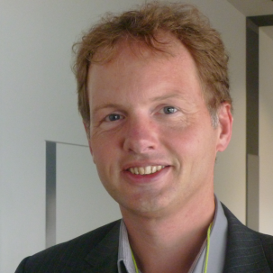




thank you for your attention
johan van ieperen - UITP manager IT solutions
follow me on or @2dender4

