Slide 1

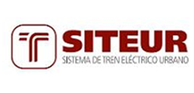

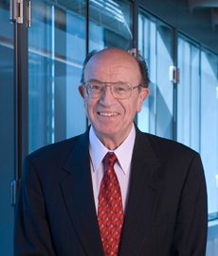

Trends in Iberoamerica’s Mobility
XXV General Meeting
Latin America Metro and Subway Association
Guadalajara, Jalisco
22 November 2011
Integral Mobility Systems
for Metropolis
Dr Vukan R Vuchic
Emeritus Professor
University of Pennsylvania

Slide 2
Presentation Outline
Present Condition of Urban Transportation
Development of Transportation and Cities in the 20th/21st Centuries
The Family of Urban Transportation Modes Today
Rational Transportation Policy Formulation Requirements
Intermodal Policies and Implementation Measures
Rail and Intermodal Transit Systems
Rail Transit Lines and Networks Planning and Design
Special Lines and Operations
Stations: Types, Locations and Spacings
Review of Experiences and Prospects in Urban Transportation

Slide 3
Present Condition of Urban Transportation,
Progress and Problems
Present transportation systems provide:
  Very high mobility for population
  Great economic and lifestyle benefits
Problems remain:
  Quality of service, speed and reliability are often unsatisfactory
  Inequities and serious problems of auto dependency and neglected other modes: public transit, walking, bicycling
  Transportation produces negative impacts on cities and their livability or quality of life

Slide 4
Development of Transportation and Cities
in the 20th/21st Centuries
- The twentieth century started with rapid growth of cities and industrialization
- Around 1900, mechanical transportation was just introduced
- Initially “Walking Cities” were upgraded by the invention of electric transit (public transportation)
- Between 1900 and 1950 development of “Transit Cities:”
  Extensive transit services on streets
  Independent, high-performance systems - metro or rapid transit

Slide 5
Development of Transportation and Cities
in the 20th/21st Centuries (cont.)
- In the USA from 1930, and other countries from 1950:
  Creation of “Automobile Cities”
  Maximum growth of highways during the 1950-70 period
- The field of Traffic Engineering was developed
- Cities which focused on automobile-truck and highways while neglecting transit and pedestrians created major problems:
  Congestion
  Excessive highway and parking construction
  Non-auto users have become second-class citizens
- Today, cities with largest motorway/Autobahn systems have most severe congestion, deteriorated environment and quality of life.

Slide 6
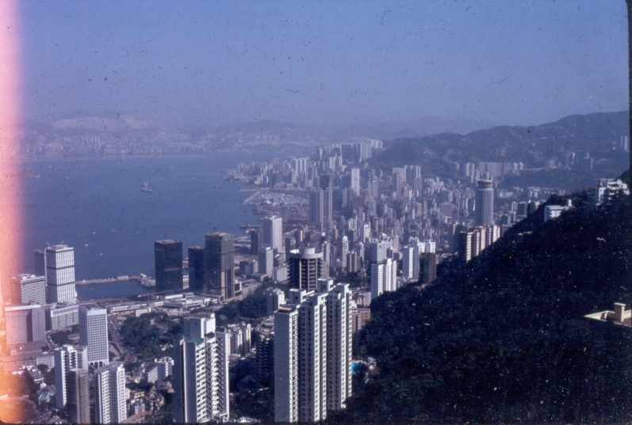

Slide 7
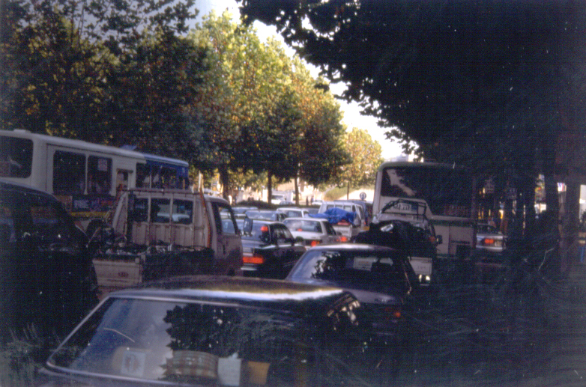

Slide 8
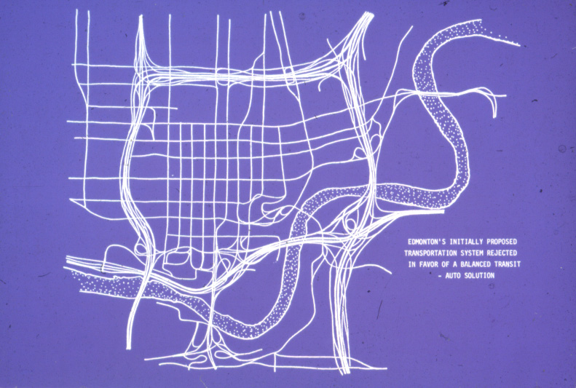

Slide 9
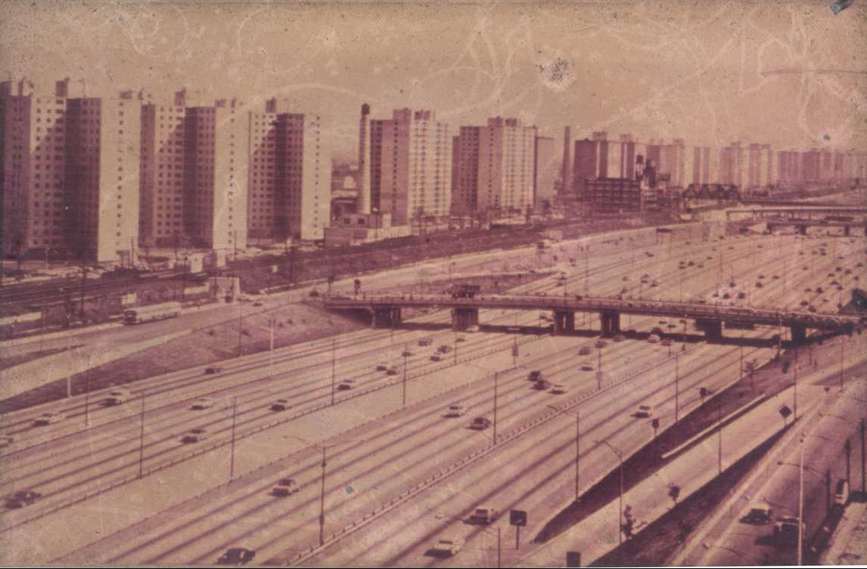

Slide 10
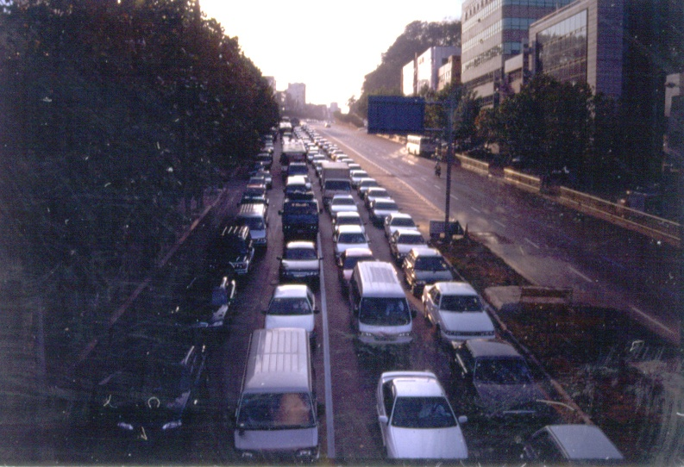

Slide 11
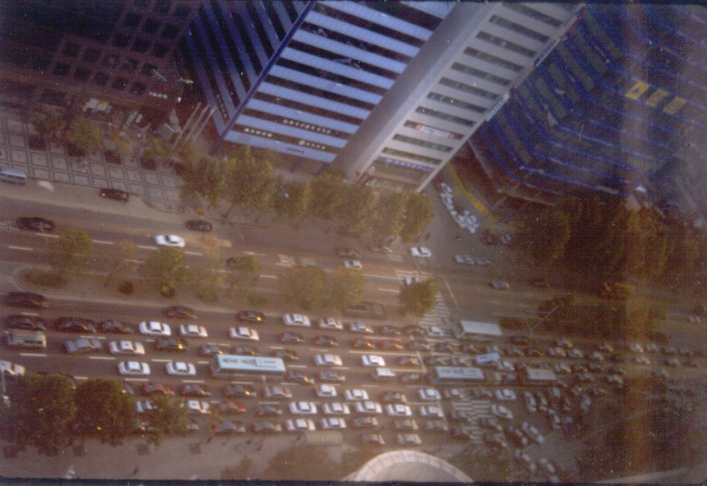

Slide 12
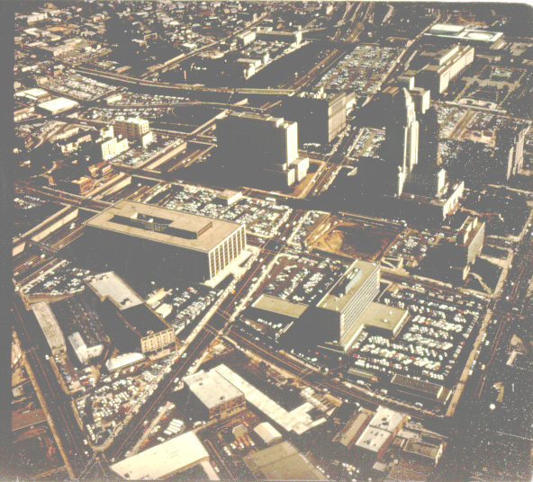

Slide 13
Development of Transportation and Cities
in the 20th/21st Centuries (cont.)
- Studies of urban transportation policies suggest:
  Relationship of cities and transportation is very complex
  “Systems Approach” is necessary
  There is a need to recognize quality of life or “livability”
- Since the 1970’s focus has been on developing “Intermodal Cities:”
  Large cities relying on a number of coordinated modes
  More travel choices
  Improved efficiency, comfort, safety and reliability
  Reduce negative environmental impacts
  Refocus on human scale activities

Slide 14
The Family of Urban Transportation Modes Today
Intermodal cities rely on many modes of transport - each one has its strengths and limitations. The family of modes includes:
  Street / road system with automobiles, trucks, bicycles
  Basic network in every city
  Two major social benefits: convenience and ubiquity
  Traffic engineering and ITS becoming more important
  Walking
  Optimal mode for high density travel
  Environmentally friendly
  Key component of urban “livability”

Slide 15
The Family of Urban Transportation Modes Today (cont.)
  Bus transit
  Lowest cost mode of public transportation
  Does not compete easily with private auto
  Upgrading to Bus Rapid Transit intensified
  Tramway and Light Rail Transit:
  Many innovations in recent decades
  Filling the gap: higher performance than bus, less expensive than metro
  Built in medium and large cities (15 new systems in North America, many in Europe)
  Many diverse applications

Slide 16
The Family of Urban Transportation Modes Today (cont.)
  Metro or Rail Rapid Transit
  Highest capacity – lowest land and energy consumption
  Very effective in large urban areas
  Speed and reliability make it competitive with private car
  Regional Rail
  Taxi, minibuses, jitneys
  Automated Guided Transit (AGT)
  Intermodal Transit System:
  Operationally and organizationally integrated modes

Slide 17
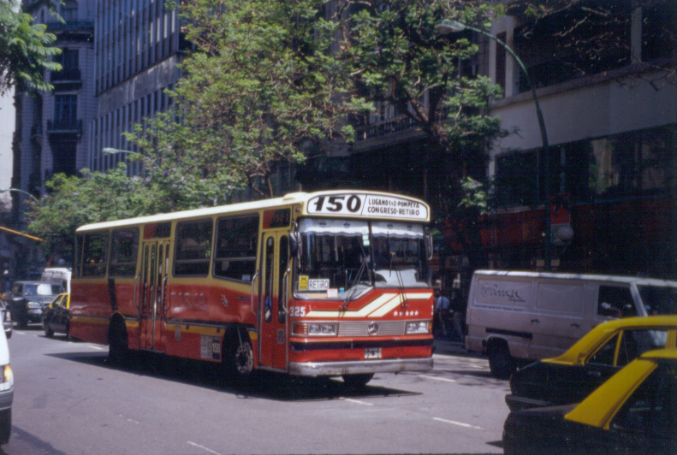

Slide 18
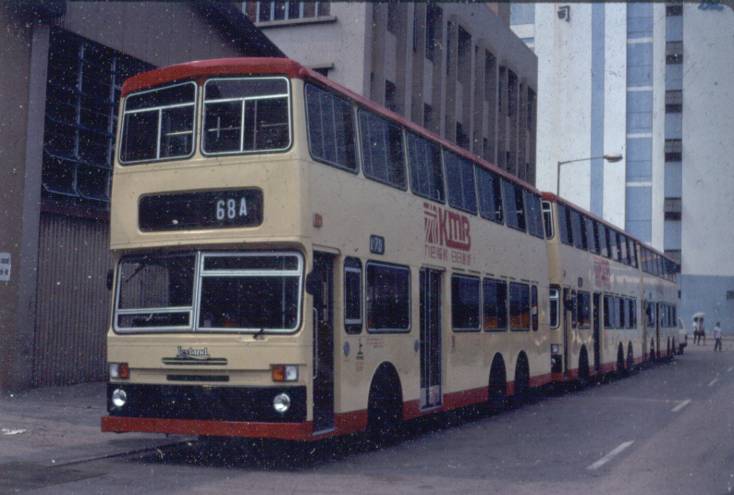

Slide 19
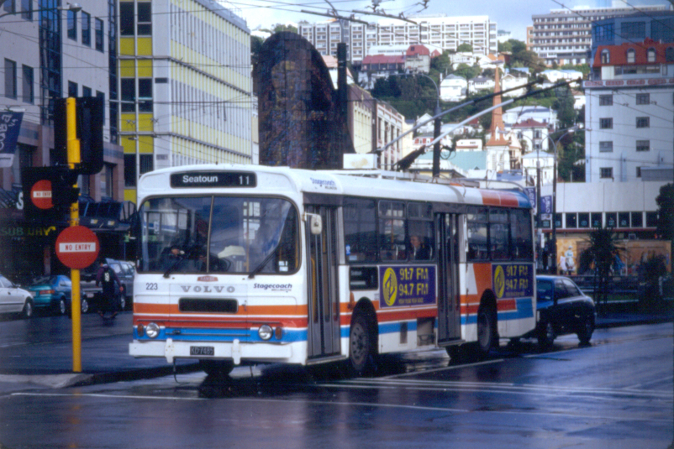

Slide 20
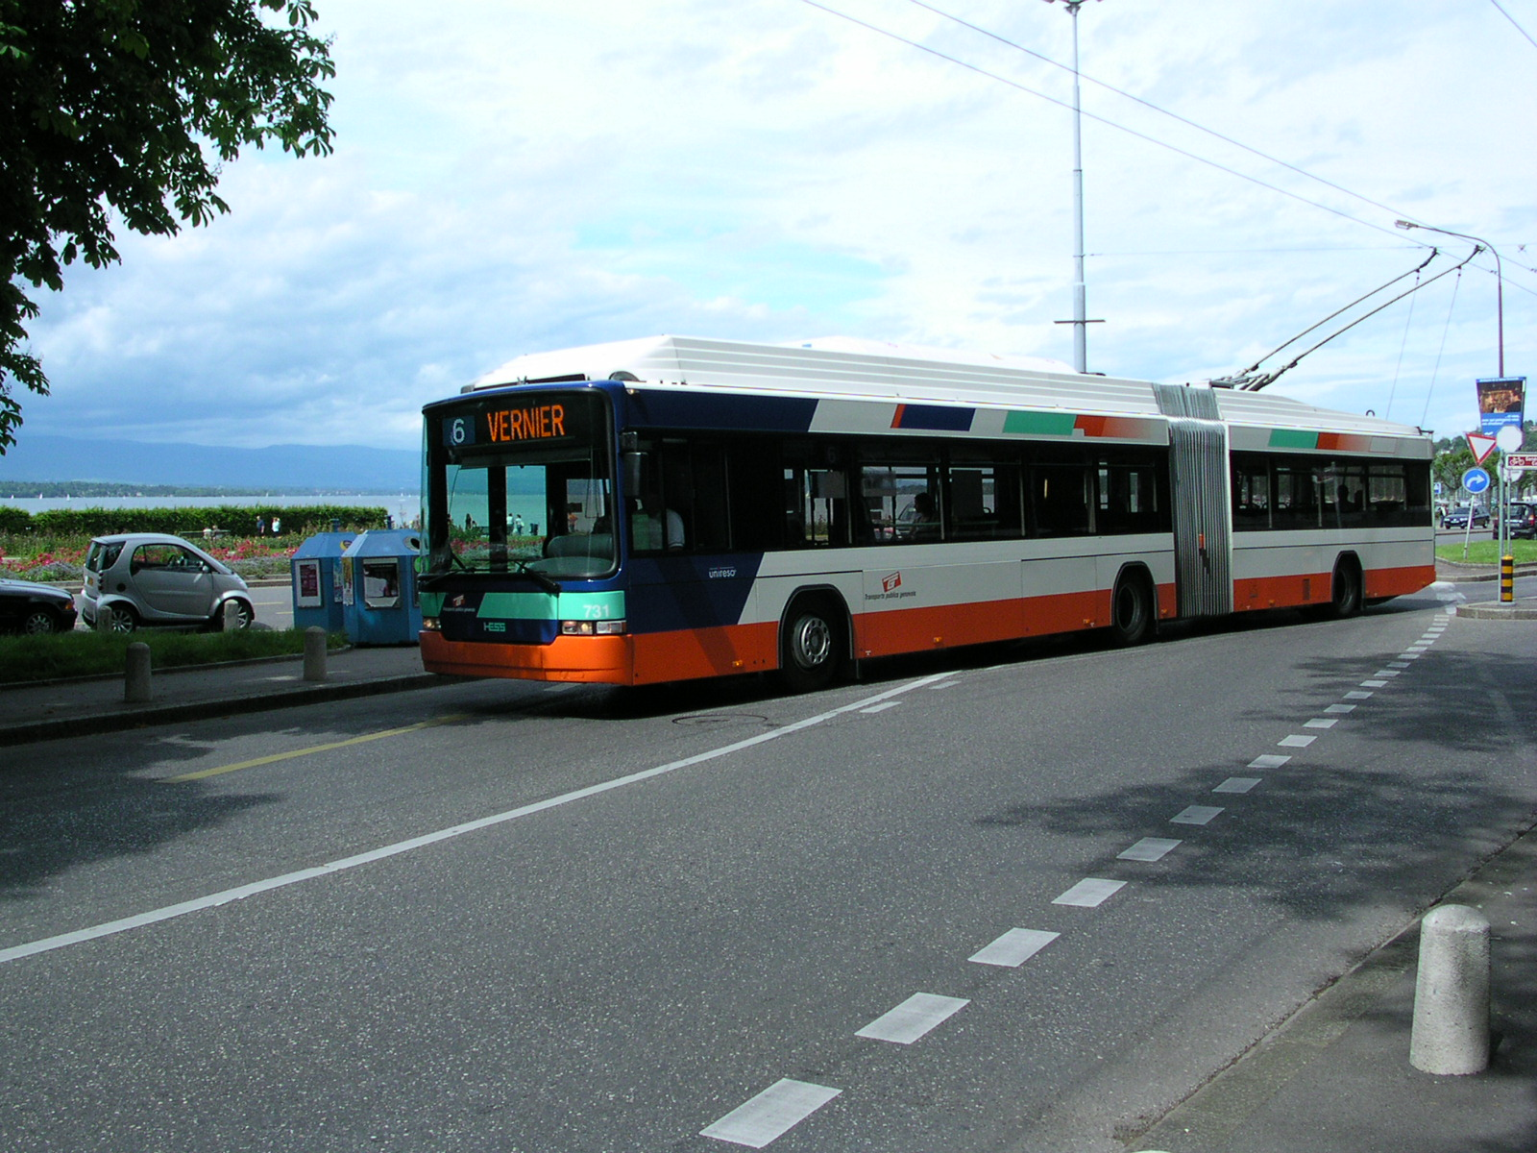

Slide 21
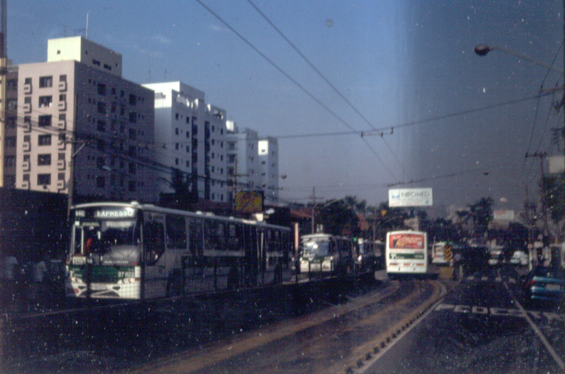

Slide 22
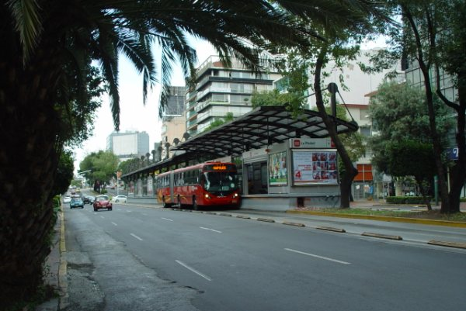

Slide 23
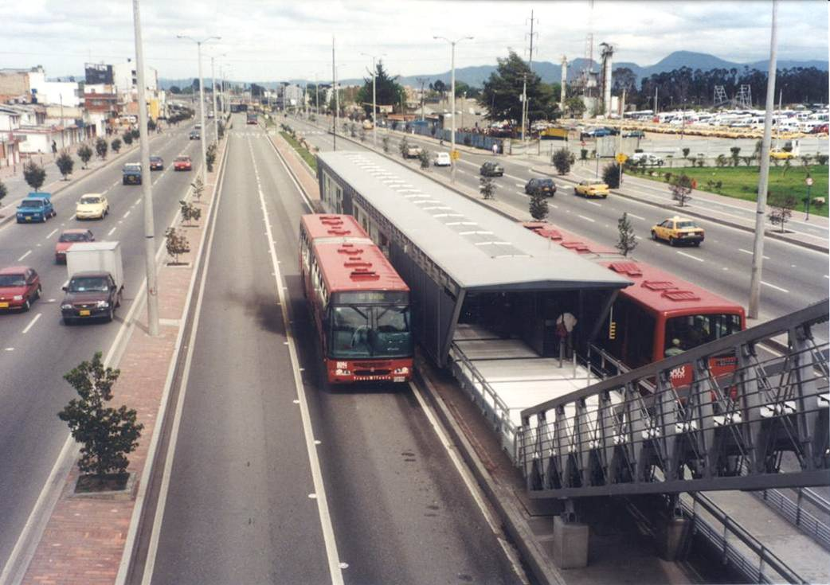
Photo 5.24 TransMilenio BRT
Courtesy: TransMilenio BRT, Bogota, Columbia

Slide 24
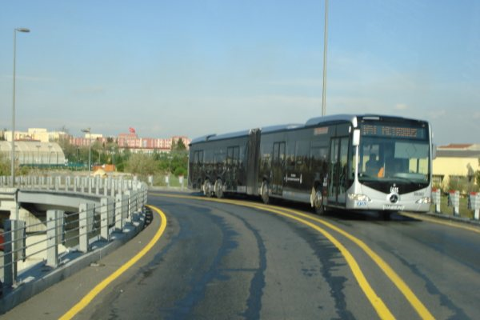

Slide 25
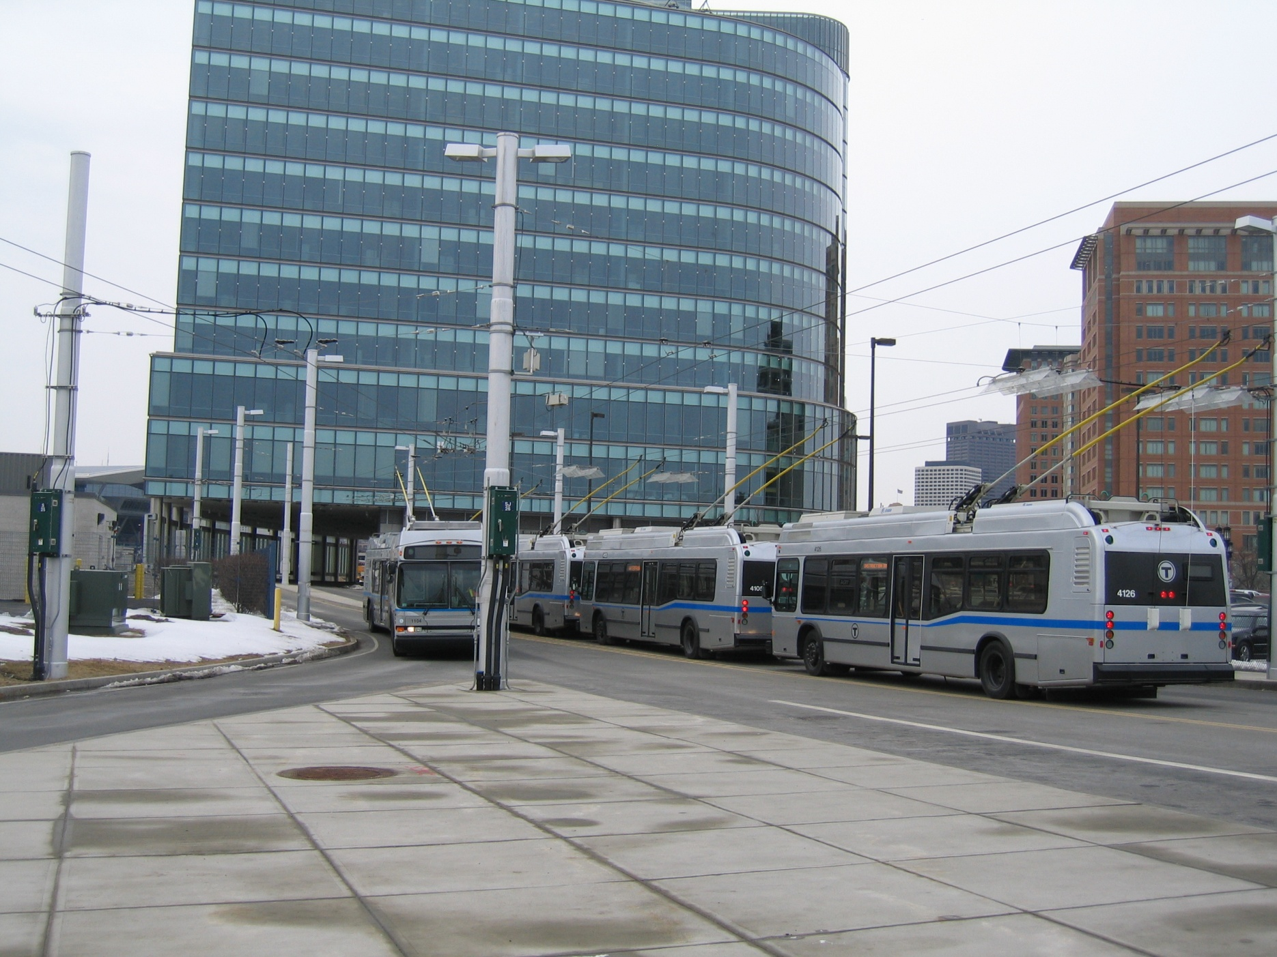
Photo 5.29 Boston Silver Line

Slide 26
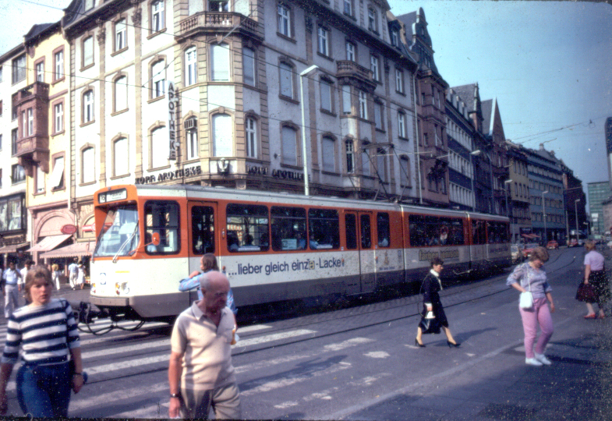

Slide 27
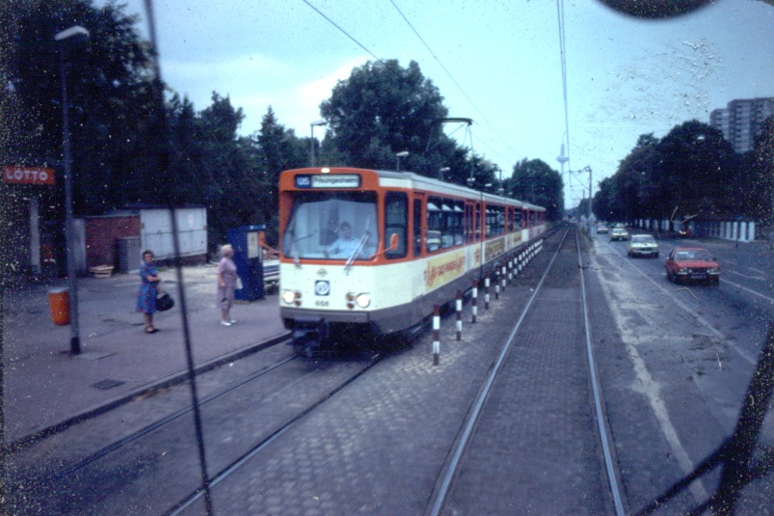

Slide 28
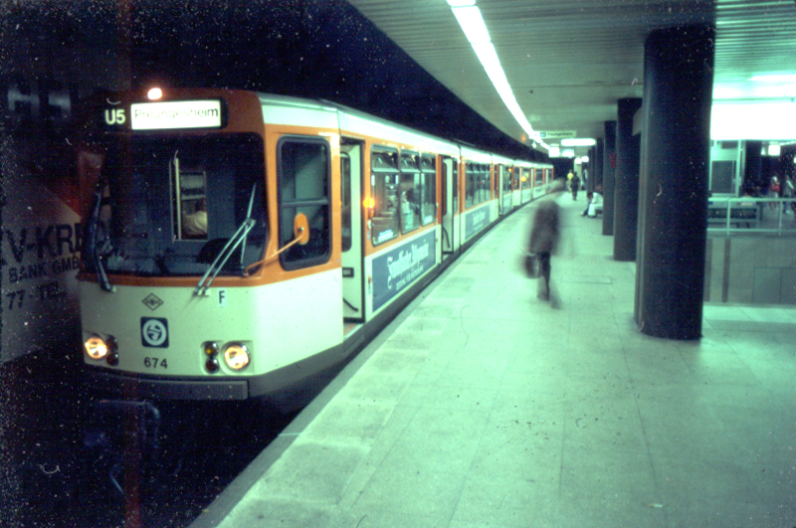

Slide 29
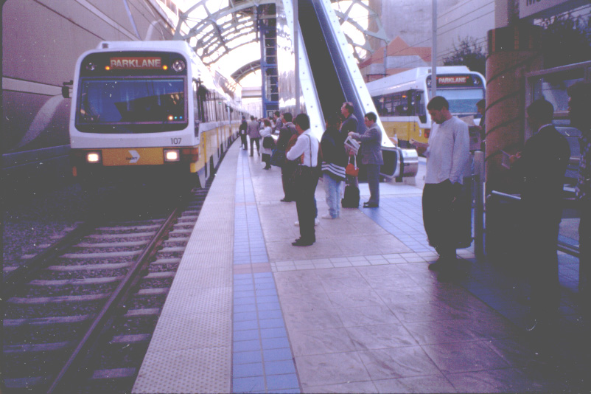

Slide 30
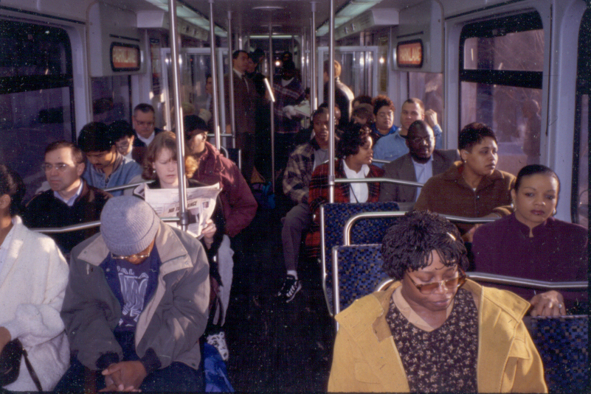

Slide 31
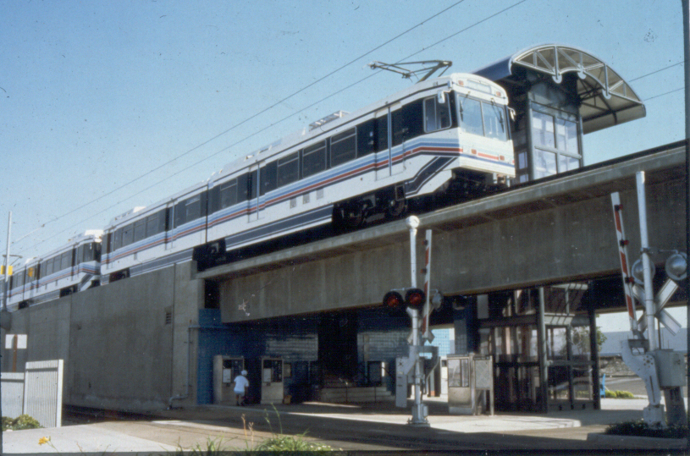

Slide 32
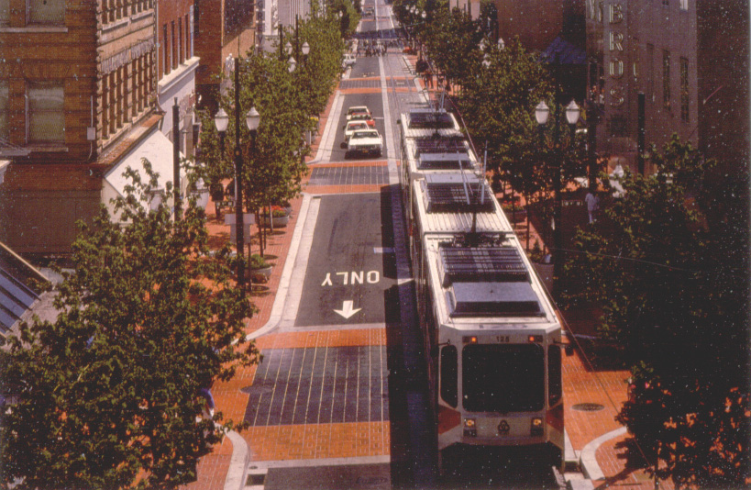

Slide 33
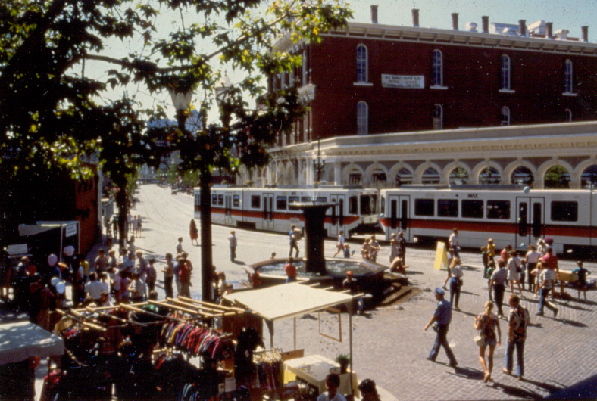

Slide 34
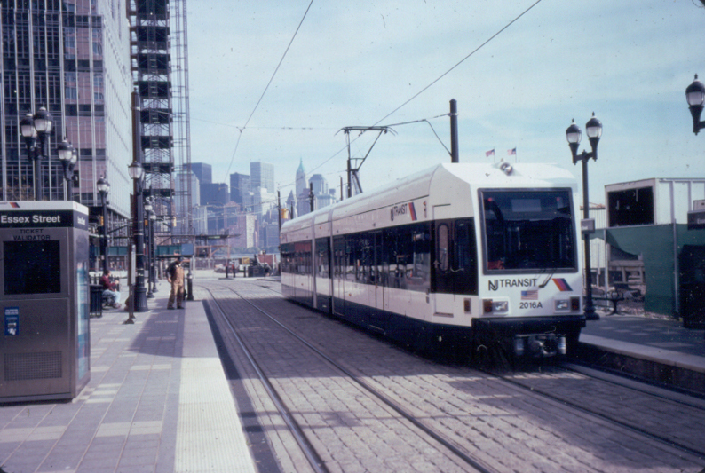

Slide 35
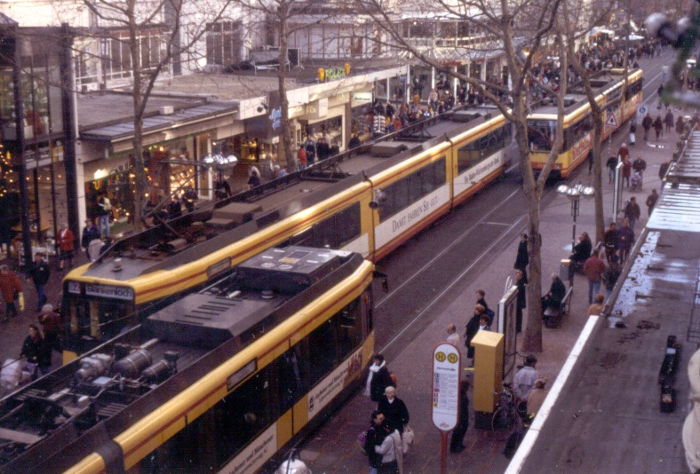

Slide 36
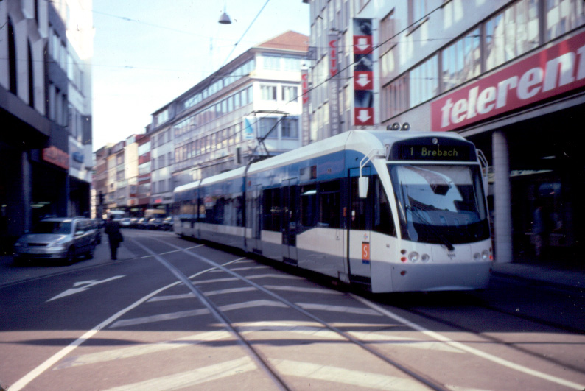

Slide 37
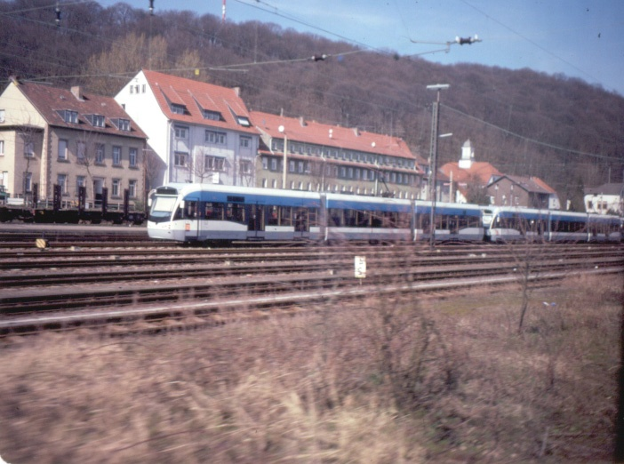

Slide 38
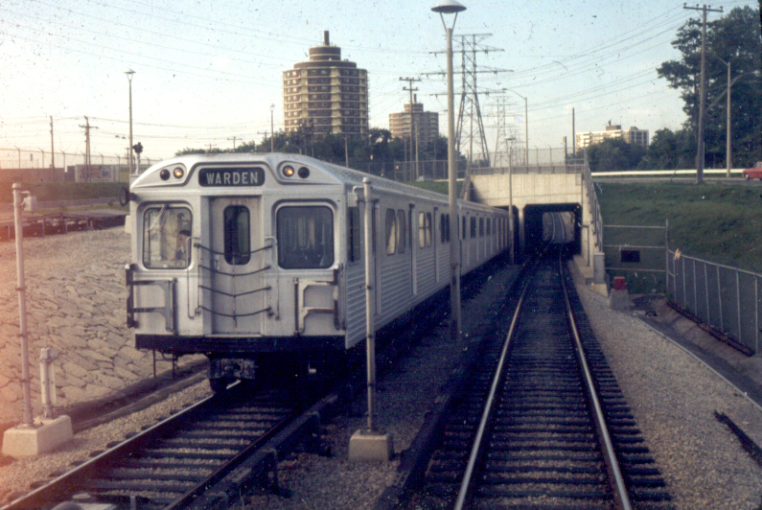

Slide 39
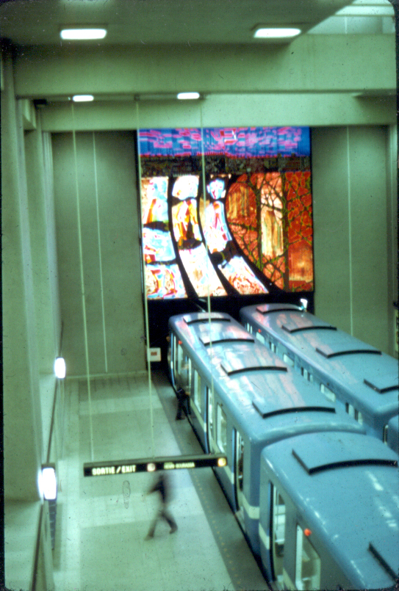

Slide 40
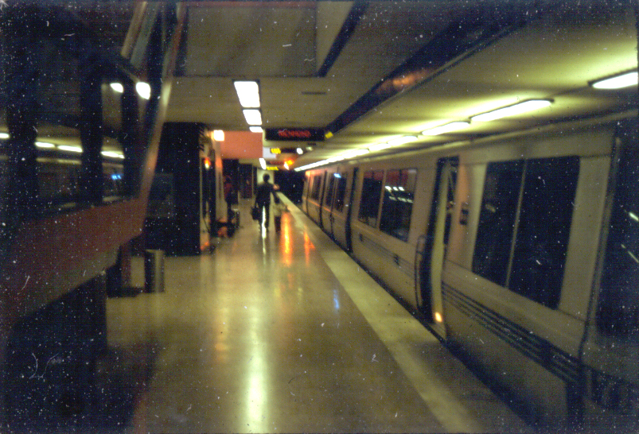

Slide 41
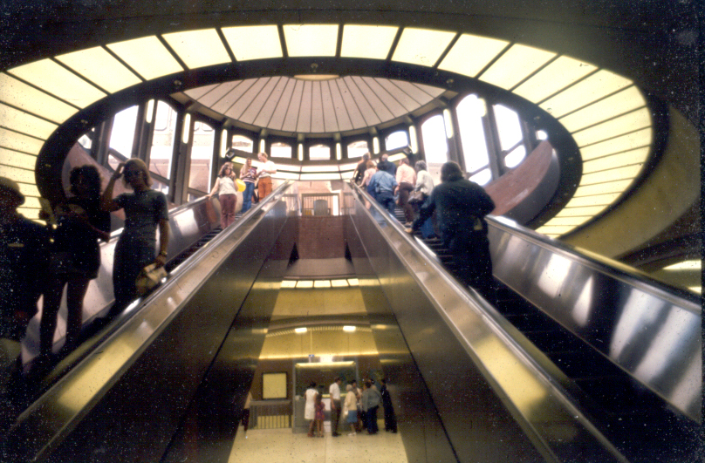

Slide 42
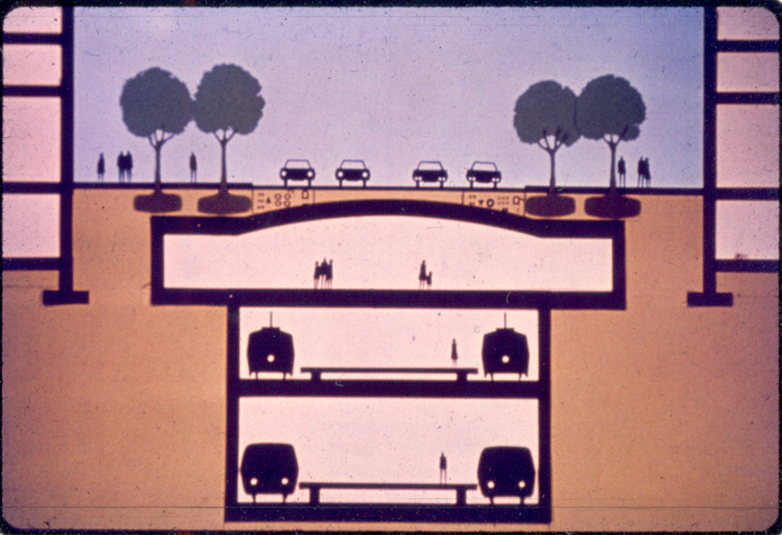

Slide 43
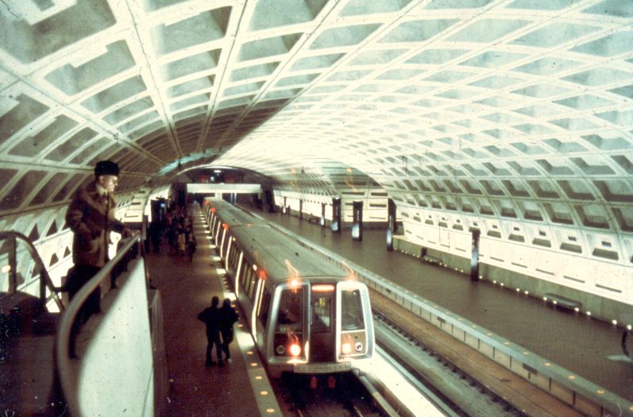

Slide 44
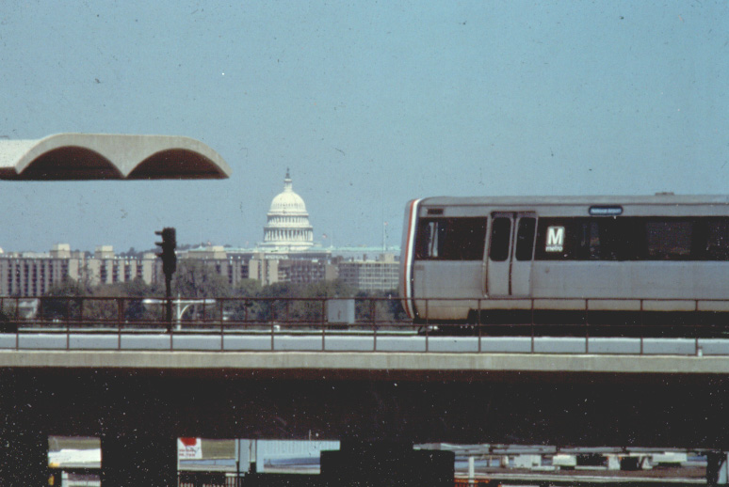

Slide 45
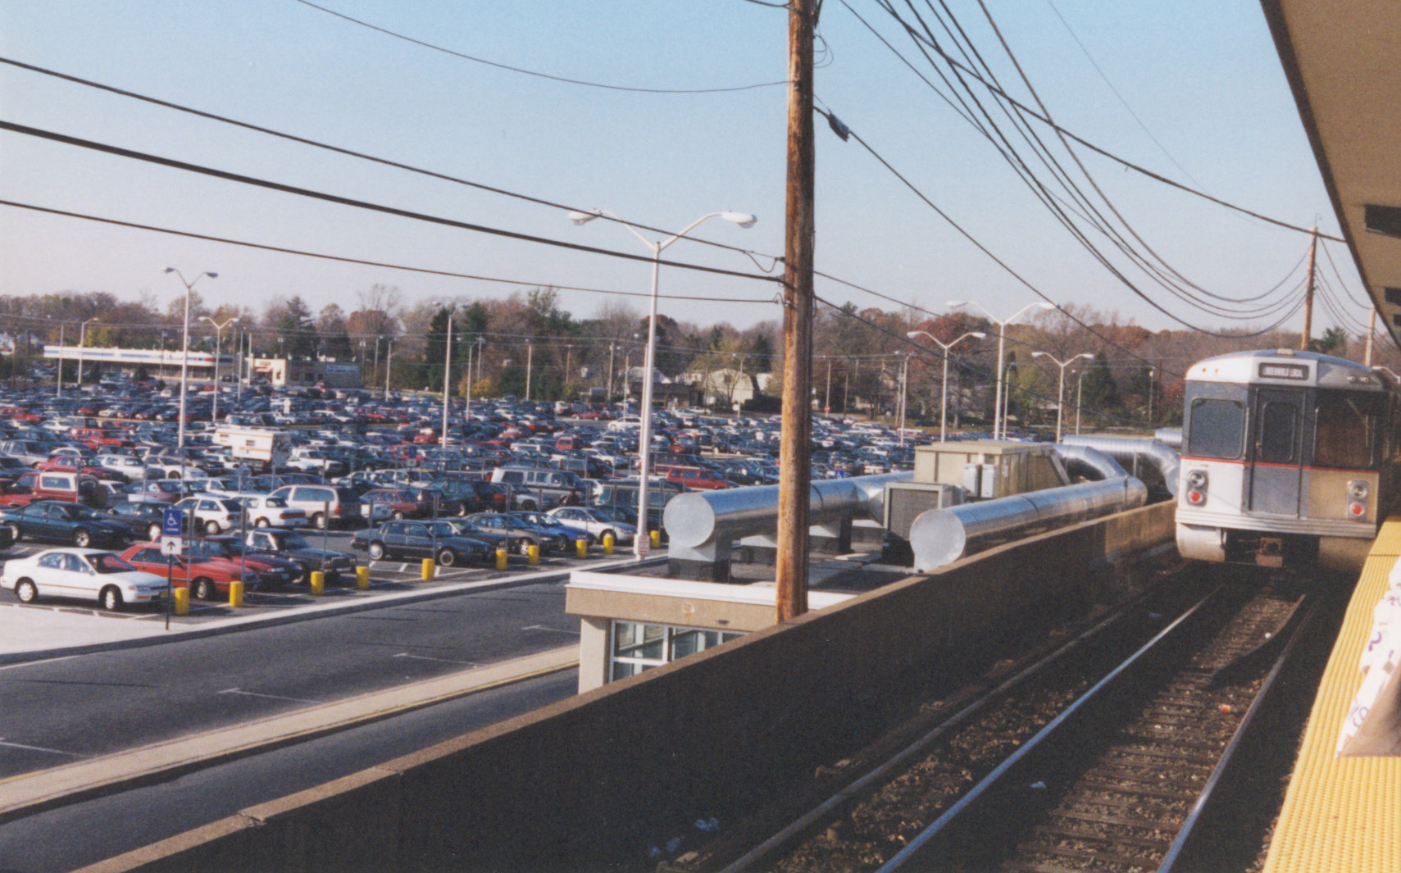

Slide 46
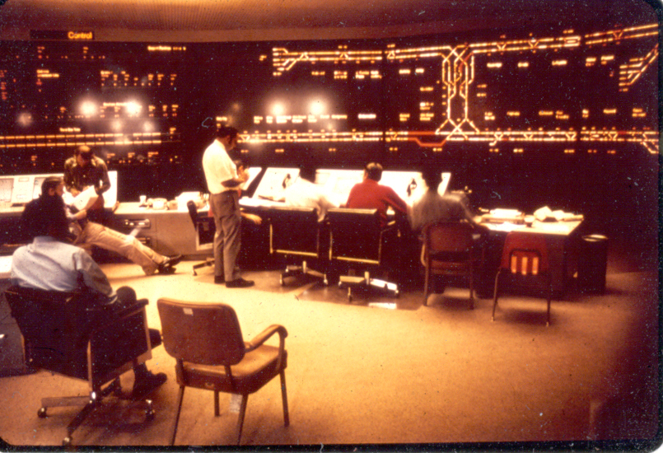

Slide 47
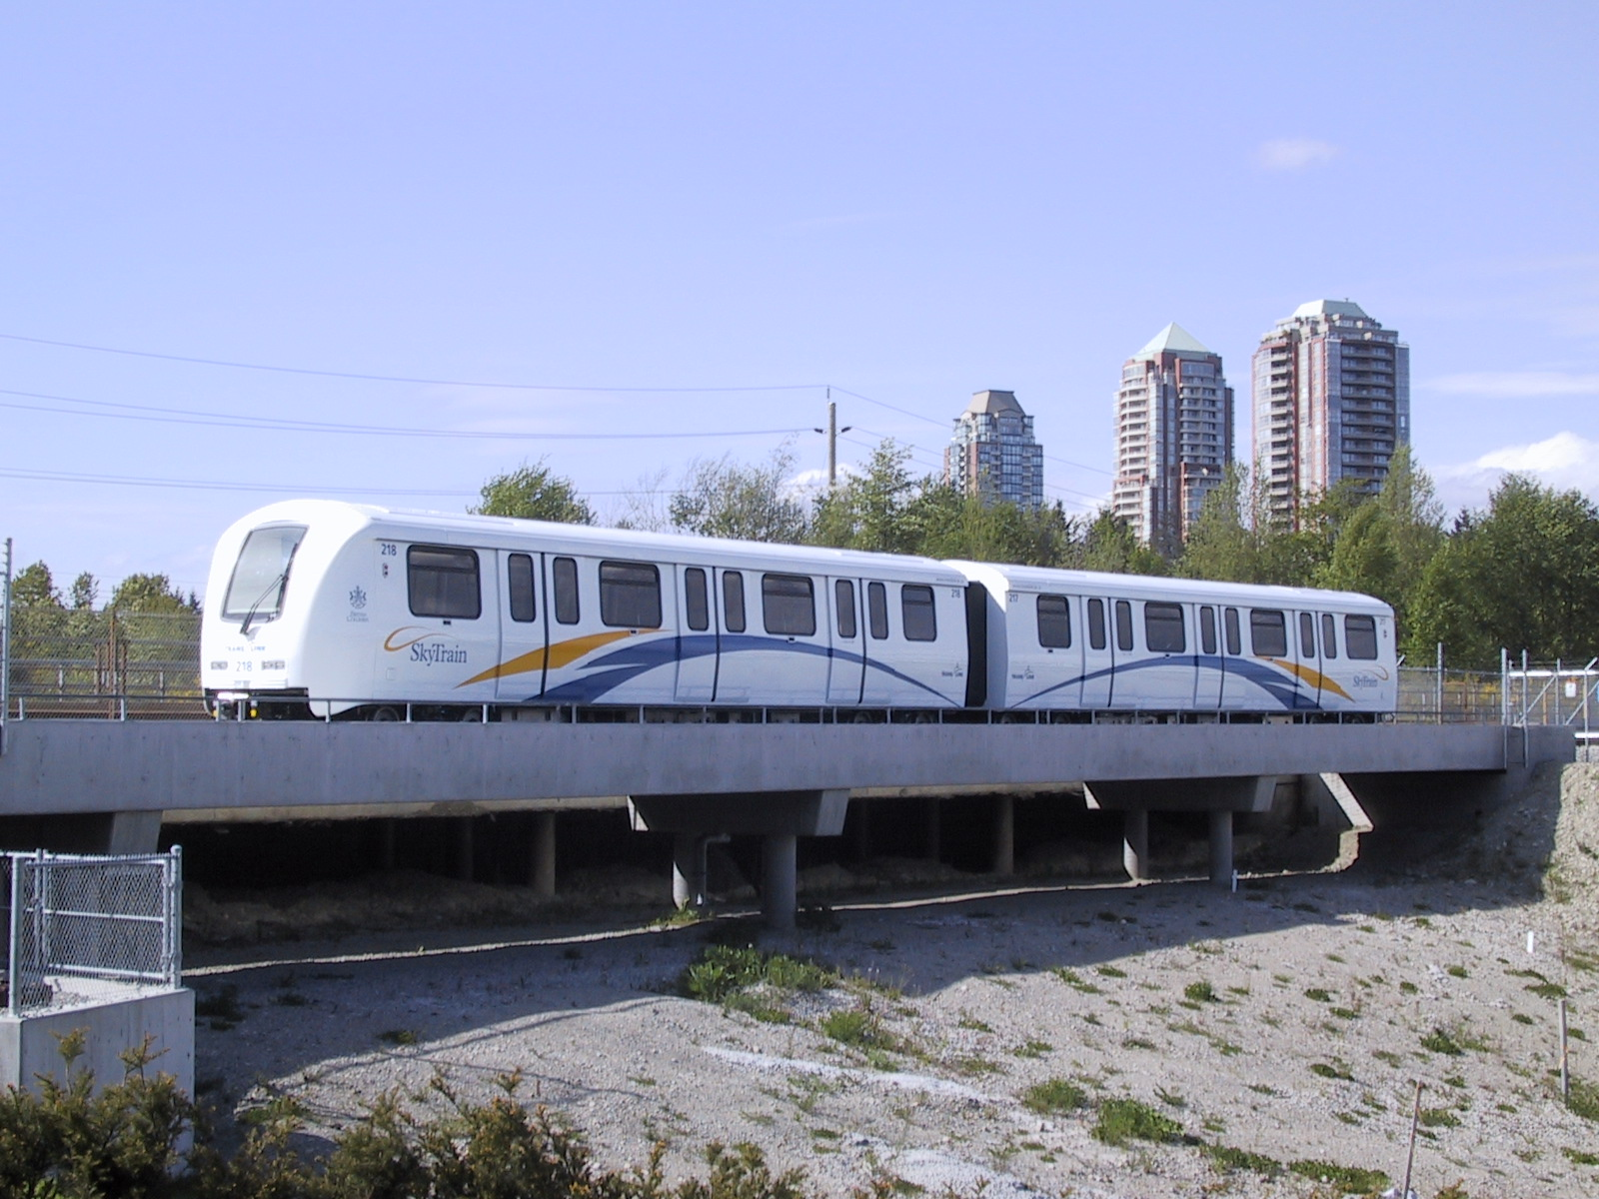

Slide 48
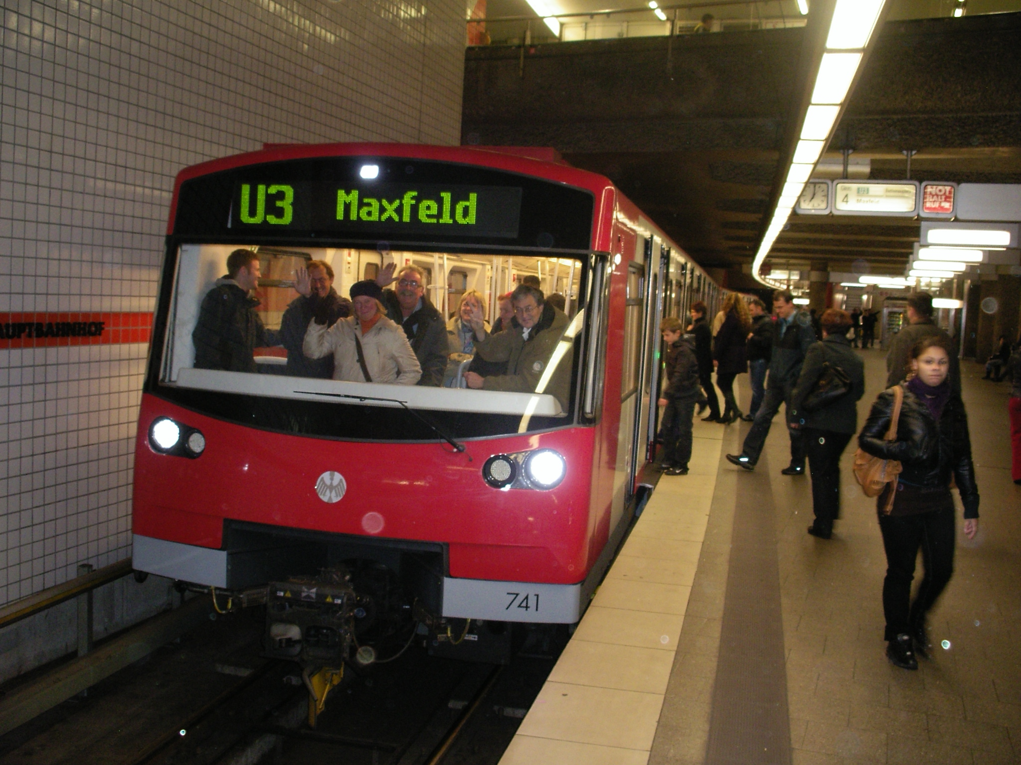

Slide 49
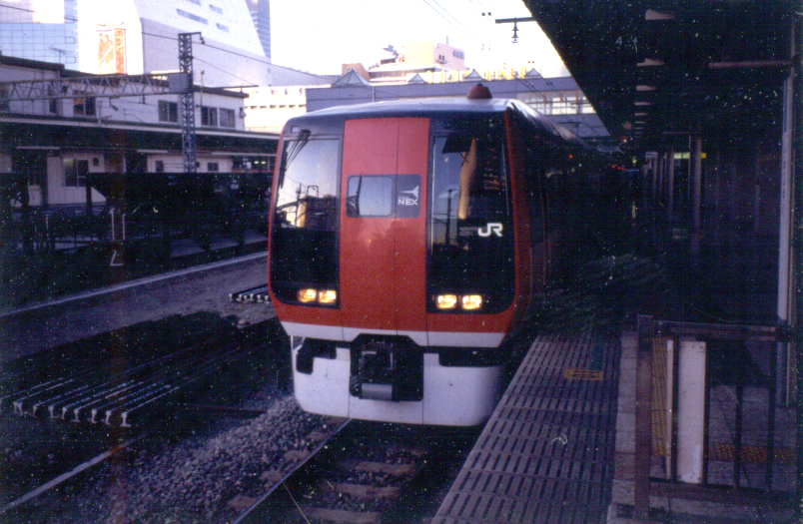

Slide 50
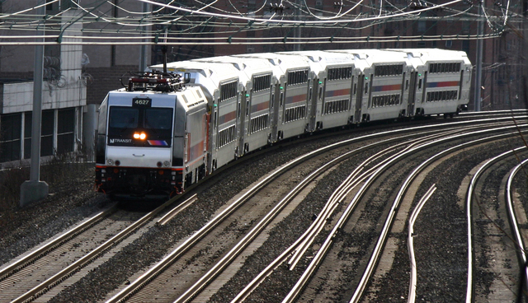

Slide 51
4.1 Rational Transportation Policy
Formulation Requirements
Understanding transport
function and interactions
Conditions and trends
Define goals and objectives
Future travel
Political and
public support
Design transport system
and facilities
Technical expertise
Financing
Organization and
management
Build and operate
transport system

Slide 52
4.2 Functional Role of Transport in a City
Government
Housing
Economy
Social conditions
City
Industry
Culture and
recreation
Environment
Transport

Slide 53
4.5 Conceptual Structure of Urban Transportation Planning
LEVEL IV
Planning, design, operation of single facility
Plaza
Intersection
Single route
LEVEL III
Coordination of single mode network/system
Urban streets
or
Transit network
Transit
Auto-highway
LEVEL II
Integration of multimodal network/system
Pedestrian
Economy
Housing
LEVEL I
City – transport balance
CITY
Transport
Social conditions
Environment

Slide 54
4.6 Planning Level Sequence in Urban Transport:
Hierarchy of goals and objectives
I. DEFINE TYPE OF CITY/SOCIETY
II. DETERMINE MODE COMPOSITION
III. DESIGN MODE NETWORKS
IV. DESIGN INDIVIDUAL FACILITIES

Slide 55
5. 1 Intermodal Policies and Implementation Measures
Having understood the fundamental problems, transportation professionals should balance
Individual Behavior and System Optimum by:
Transit incentives: building high-quality, competitive transit systems, fare innovations, positive attitude toward passengers, marketing, etc.
    Transit incentives are easily justified and popular
    Auto disincentives: traffic reduction policies, economic policies (parking rates and structure, road pricing)
    Politically more challenging, but justified and rational.

Slide 56
5.2 Implementation Policies and
Implementation measures (cont.)
Direct costs of urban travel by different modes
10
8
Toll
Cost [$/person-trip]
6
Fare
Parking
4
2
Gasoline
0
Auto Peak
without
Parking, Tolls
Auto
Large City - Peak
Bus / LRT / Metro
Express Bus /
Regional Rail

Slide 57
5.3 Implementation Policies and
Implementation measures (cont.)
Total costs of urban travel by different modes
10
Toll
Parking
Fare
5
Gasoline
0
Indirect
user cost
Subsidy
Environ-
mental
Cost [$/person-trip]
Subsidy
5
Social
Environ-
mental
10
Social
15
20
Auto
Large City - Peak
Auto Peak
without
Parking, Tolls
Bus / LRT / Metro
Express Bus /
Regional Rail

Slide 58
6.1 Intermodal Transportation Systems
    They consist of modes which are integrated in the following ways:
        Physically (joint transfer stations)
        With coordinated schedules
        Joint fares
        Integrated information.
        Rail transit is the main carrier in intermodal systems of most medium and large cities.

Slide 59
6.2 Characteristics of Rail Transit
Rail transit characteristics
  Rail – simple support and guidance
  Low energy consumption
  Use of trains – very high capacity
  Separate rights-of-way: B or A
  Electric traction – no air pollution in city
High investment – high performance

Slide 60
6.3 Three Categories of Transit Modes
by Right-of-Way Category
Category C - Street ROW, mixed traffic - Tramway
Category B – Longitudinally separated: Semirapid transit – Light Rail Transit - LRT
Category A – Full separation: Rapid transit or Metro and Regional Rail

Slide 61
6.4 Family of Rail Transit Modes:
Definitions and Illustrations
Tramway (Streetcar)
Light Rail Transit - LRT (Light Metro)
- Light Rail Rapid Transit - LRRT
Metro/Rapid Transit (Subway, Underground, U-Bahn)
- Regional Metro
Regional Rail (Commuter Rail)
  - Tram - Train

Slide 62
ROW categories
Investment cost / line length
A
Metro
Rapid transit
C
Bus
Street
transit
System performance: speed, reliability, capacity, image
Bipolarized transit: street and rapid transit

Slide 63
ROW categories
Investment cost / line length
A
Metro
LRT
Rapid transit
B
BRT
Semirapid
transit
C
Bus
Street
transit
System performance: speed, reliability, capacity, image
Intermediate systems “filling the gap” between street transit and metros

Slide 64
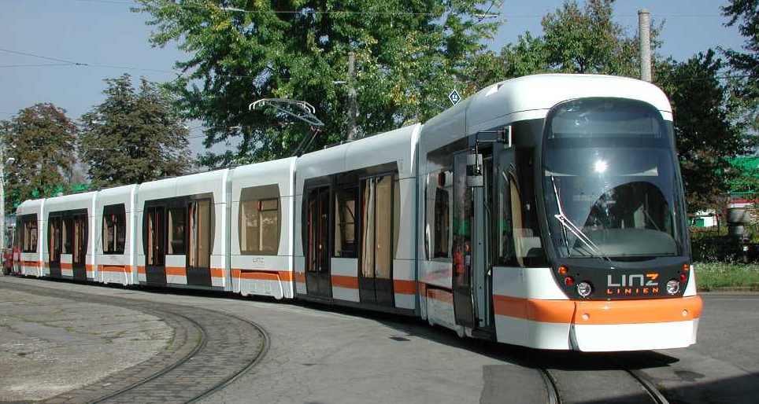
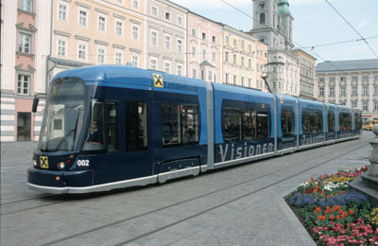
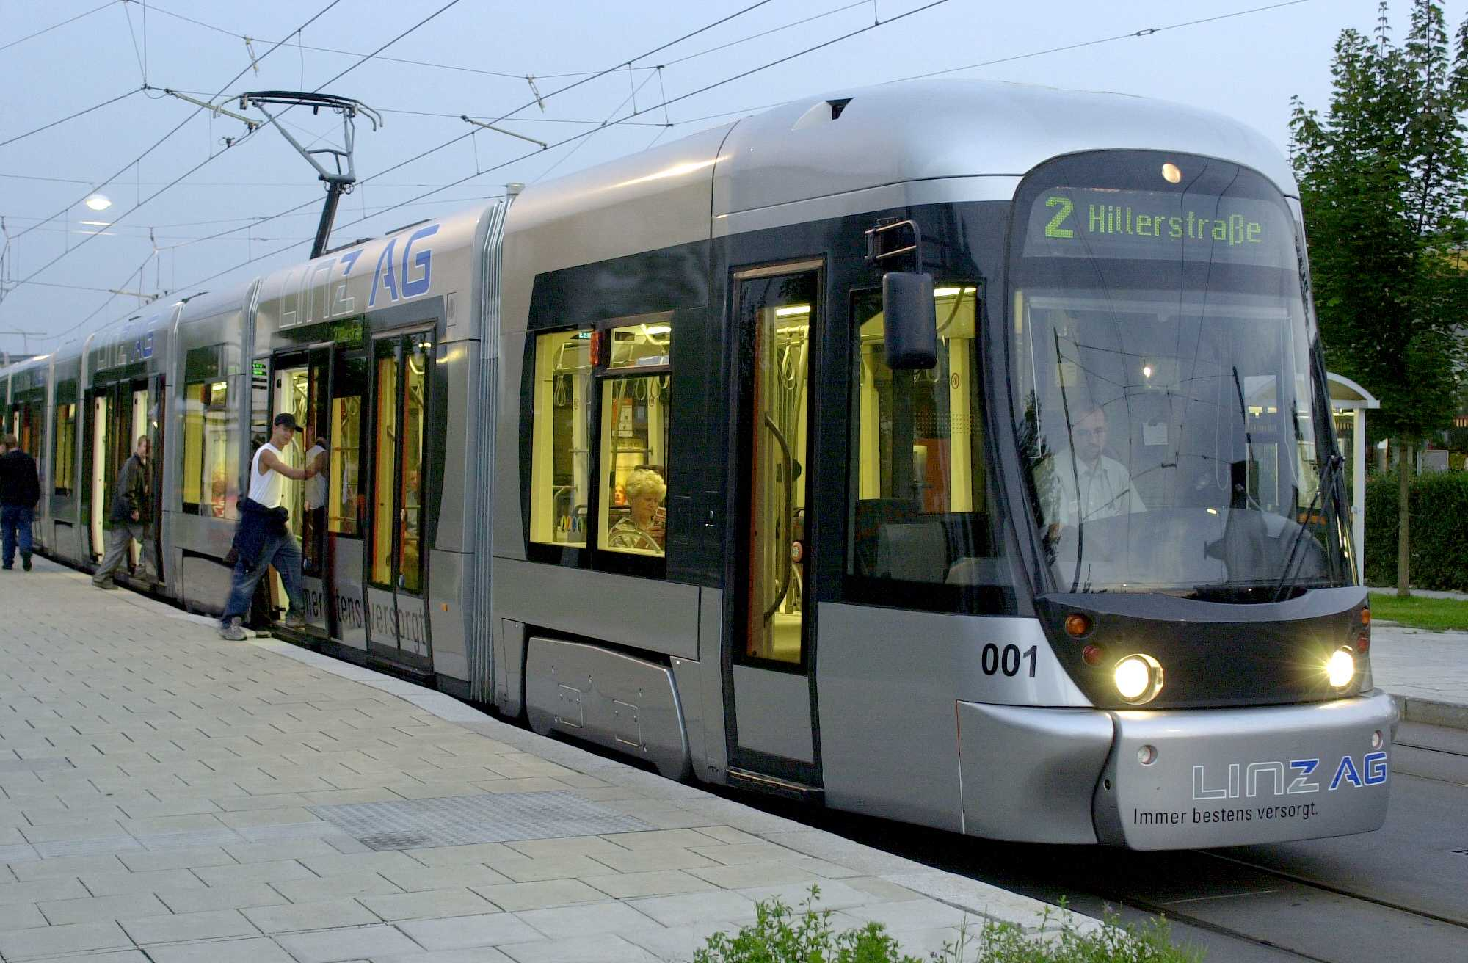
LINZ

Slide 65
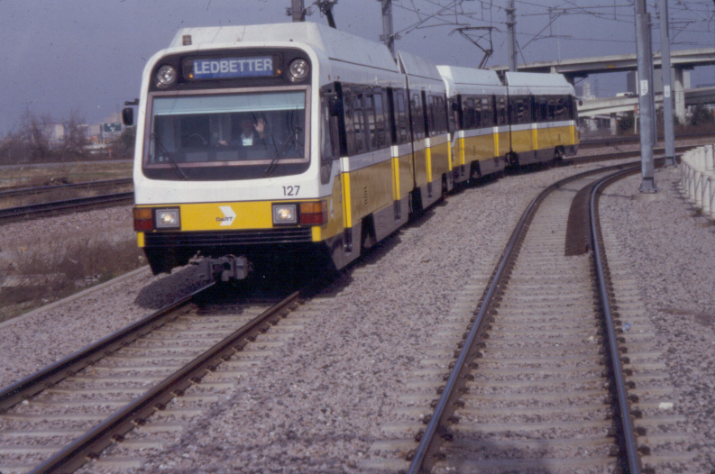

Slide 66
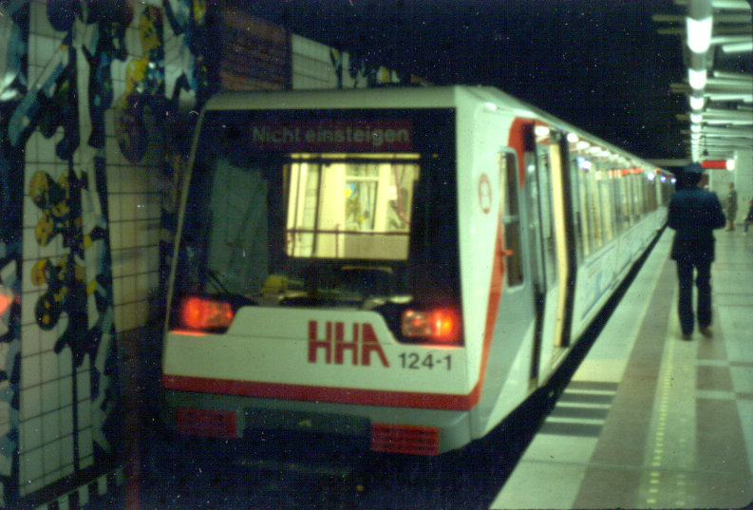

Slide 67
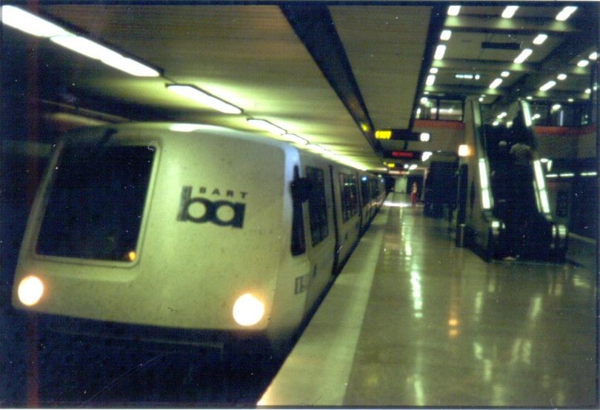

Slide 68
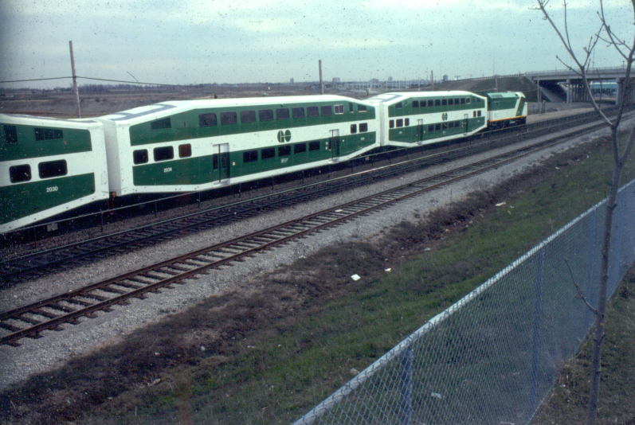

Slide 69
7.1 Rail Transit Line and Network
Planning and Design
Major elements and considerations:
Geographic layout/conditions (water, hills)
Alignments of major passenger flows
Selection of right-of-way (ROW) and transit mode
Network topology
Operating efficiency
Intermodal planning

Slide 70
7.2 Upgrading of Transit Modes
With increasing passenger volumes operation of many ovelapping bus lines become inefficient
Upgrading of service through consolidation of lines usually results in separation of ROW and replacement of buses by rail
Consolidation of lines is greater on rail than on bus systems, but its optimal pattern varies with many factors

Slide 71
7.3 Important Aspects in Transit
Lines and Network Design
Geometric types and their characteristics
Alignment and ROW (tunnel depth), ROW separation
Trunks only or with branches
Independent vs integrated lines
  Trade offs
  Criteria
Compatible vs incompatible technologies
Types of stations

Slide 72
a. Trunk with branches
b. Trunk with feeders
Radial transit lines: trunk with branches and with feeders

Slide 73
Transfer station
LRT
Central
City
Central
City
Buses Only
LRT and Buses
Change from an extensive bus network into an intensive, more efficient and attractive LRT/Bus network (Sacramento, CA)

Slide 74

Line Type
1 Radial with branches
2 Diametrical with branches
3 Diametrical with loop
4 Tangential (crosstown)
5 Circle or ring
6 Diametrical
Transfer station
Terminal station
Geometric forms of transit lines

Slide 75
7.4 Classification and Characteristics of
Line and Network Types
Diametrical vs. radial lines
Types of diametrical lines: “I”, “Y”, “X”, “L”, “U”, “T”
Circle or ring lines
Single lines vs. lines with branches, how many branches?
Independent vs. integrated lines
Transit nodes: intramodal and intermodal transfers

Slide 76
7.5 Diametrical vs. Radial Lines
Better center city distribution
Greater line connectivity
Longer lines have higher operational efficiency
No terminals in city center

Slide 77
Kenosha
McHenry
Lake
Antioch
McHenry
Fox Lake
Harvard
Lake Michigan
Kane
Cook
Elgin
DuPage
Line designation by terminals
Geneva
Chicago CBD
Aurora
G, M, H, K(Kenosha)
Will
E, F, An
Randolph Station
Orland Park
93rd. St.
Joliet
To South Bend
Ogilvie Tr. Center
Union Station
La Salle Station
Au, O, J (North)
University Park
J (South), SB
U, 93 rd.
Chicago CBD
Typical radial regional rail network: Metra in Chicago

Slide 78
Evanston
Skokie Swift
Purple
Yellow
O’Hare
Lake Michigan
Blue
Ravenswood
Red
Brown
Lake street
Downtown network
Green
Congress
Blue
Douglas
Orange
Br
Green
P
R
G
Br, G, O, P
Red
B_{L}
“The Loop”
Midway
Eaglewood
Jackson Park
Br, O, P
G
R
O
G
Dan Ryan
Downtown network
A radial/diametrical rapid transit network with CBD distribution Loop: Chicago

Slide 79


a. Typical metro line with dominant trunk
b. Typical regional rail line with dominant branches
Diametrical lines with branches

Slide 80
7.6 Trunk with Branches vs with Feeders
Branches provide for passengers continuous service without transfers between center city and suburban areas
being longer lines trunk and branches have smaller percentaje of cycle times as terminal times than trunk with feeders
Transfer stations are not needed
Each feeder line can be optimized
Trunk with feeders offers more reliable service and higher performance

Slide 81
7.8 Independent vs. Integrated Lines
Independent lines are operationally very simple – important when capacity is reached
Integrated lines – with branches and joint sections:
+ Reduce need for transfers
+ Balancing of frequencies increases capacity utilization
+ Allow changes in line routings
+ Economies of single rolling stock, shops & control center

Slide 82
A
B
A
B
Terminal Station
Transfer Station
F
C
F
C
E
D
E
D
Independent operation: 3 lines
Integrated operation: 15 routes
A theoretical transit network with independent and with integrated line operations.

Slide 83

Cologne (Koln) LRT - a
radial-circumferential
integrated LRT network

Slide 84
5, 6, 7, 15
Main railway station
1, 2, 4, 9, 11, 14
9, 11, 14
2
9, 11, 14
Liederhalle
1, 2, 4, 11
9
5, 6, 7, 15
11, 14
15
4
4, 9
Charlotten platz
City hall
1, 2, 4, 11
2, 4, 11, 14
15
2, 4, 11
5, 6, 7, 15
1
14
1, 14
5, 6, 7
Typical light rail transit integrated network: Stuttgart center city

Slide 85
Stations:
S e i n e
Local
Terminal
Transfer
9
10
1
2
3
12
8
6
13
13
4
14
City limits
11
4
7
5
13
7b
10
14
12
7
6
2
3b
7b
3
11
S e i n e
The Paris Metro network: 14 independent lines.
8
5
1
9

Slide 86
B
6,7
5
3
4,6
2
8
B
1,5,9,A
1
9
4
7
A
8
2
Transfer station
Terminal
Station
3
The Mexico Metro network: independent lines including “I”, “L” and “T” types

Slide 87


Slide 88
9
7
6
2
1
3
5
4
5
3
4
10
5
8
5
8
7
1
11
11
10
6
Station
2
Terminal
9
Transfer station
The Moscow “Metropolitan” network of independent lines – diametrical, radial and ring

Slide 89
9B
9A
6
1B
7
2
1A
3
5
4
5
3
4
10
5
8
1B
5
8
7
1A
11
11
6
10
Station
2
Terminal
9B
9A
Transfer station
The Moscow “Metropolitan” network with
possible branches for better area coverage in suburbs

Slide 90


Slide 91
7.9 Circle or Ring Lines
Advantages:
+ Serves very busy corridors – high passenger turnover
+ Provides extensive connectivity
+ Low time variations - high capacity utilization
+ Distributes and connects radials
Limitations:
- Recovery of delays is difficult
- Limited selection of service headways

Slide 92


Slide 93


Slide 94


Slide 95
BRONX
1,9
4
2
5
5
6
3
MANHATTAN
4
5
6
Broadway
1,9
Park/Lexington Avenue
2
7th Avenue
3
QUEENS
3
4
4
5
3
2
6
BROOKLYN
5
2
1,9
Schematic layout of the contiguous Division A network in New York City

Slide 96


Slide 97

Paris Regional Rail (RER) network: diametrical lines with 2-3 branches

Slide 98


Slide 99
Omni
Downtown
Legend:
Omni Loop
Brickel Loop
Downtown Loop
Metrorail
Brickel
Metrorail
Miami Downtown People Mover as a feeder to Metrorail

Slide 100

Light rail, rapid transit, and regional rail transit networks in Philadelphia

Slide 101

Trunk line with branches on both sides: Philadelphia Regional Rail

Slide 102


Slide 103
S2
SA
S1
S1, S8
S6
SA
Main Rwy Station
S3
East Rwy Station
S8
S4
S27
S3, S4, S7
S5
S5
S27
S6
S7
S1
S2
The Munich S-Bahn (regional rail) network

Slide 104


Slide 105


San Francisco Bay Area Rapid Transit (BART) Network

Slide 106

Schematic network of BART lines in San Francisco

Slide 107

Three Regional Rail networks in New York:
Metro North, LIRR and New Jwersey Transit

Slide 108
i. Separate terminals with radial lines
ii. Connected terminals with diametrical lines
a. Typical regional rail networks
Possible circle line
i. Single transfer station
ii. Multiple transfer stations
b. Radial metro networks with different layouts
Radial rail transit networks

Slide 109
8.1 Special Lines and Operations
Single-track lines or sections
Accelerated operations
  Skip-stop operation (2 tracks)
  Express/local operations (2, 3 or 4 tracks)
  Zonal operations
Timed Transfer Stations and Networks

Slide 110
9. 1 Rail Transit Stations:
Types, Locations and Spacings
Classification
    In the street (tram, LRT) vs. separated/enclosed (LRT, Metro, Regional Rail)
    Intramodal transfers
    Intermodal transfers
    Terminals: permanent and temporary
Locations
Spacings

Slide 111
9.2 Case Studies of Rail Transit Networks:
Successes and Problems
  Planning and design of rail transit networks is extremely important, but knowledge about that process is rather limited
  Diametrical lines with branches are most common
  Integrated networks have many advantages over independent ones
  “Y”, “X” and “L” lines are often successfully used
  “U” lines are inferior to “I” and “L” types
  Circle lines are functionally excellent, in spite of operational problems
  Station types, locations and spacings require very careful planning, mistakes are very costly
  Special lines (skip-stop, express, zonal and single track) can be very effective for speeding up services and increasing efficiency

Slide 112


Slide 113


Slide 114


Slide 115


Slide 116


Slide 117


Slide 118


Slide 119


Slide 120


Slide 121


Slide 122
10.1 Review of Experiences and Prospects in Urban Transportation
Examples of Conditions in Several City Categories
A. Developing countries
Many cities in Africa, Latin America and Asia face most of the listed problems:
Understanding of transportation and its role in city is often insufficient
Program of financing, particularly investments, is unstable and inadequate because of other country’s needs
Lack of financing favors low-investment/low-quality transport systems
Limited technical and managerial expertise

Slide 123
10.2 Examples of Several City Categories
B. Countries in transition: East European countries, Russia, former Soviet republics, China
- Excellent technical expertise for transit systems, but lagging in highway/traffic engineering
- Inadequate understanding of intermodal complexities and rapid increase of auto ownership lead to repetition of many errors industrial countries made at the corresponding stage of transport development
- Missing systems approach leads to inefficiencies
- Failure to develop medium-capacity transit modes – LRT and BRT

Slide 124
10.3 Examples of Several City Categories
C. Many cities in industrialized countries
Limited understanding of complex urban transport problems
Land use-transportation planning seldom coordinated
Insufficient intermodal integration
False claims that in large cities traffic congestion is inevitable is still widespread
- Special interests confuse situation by proposing paratransit, monorails and personal rapid transit as “optimal solutions”

Slide 125
10.4 Examples of Successful Cities and Their Lessons
D. Industrialized Cities Leading in Transportation Solutions
Several European, North American and Asian cities have solved most barriers and developed rational transportation systems:
- Munich, Oslo, Zurich, Stockholm, Vienna, Copenhagen, Stuttgart
- Portland, San Francisco, Toronto, Vancouver
- Singapore, Hong Kong

Slide 126


Slide 127


Slide 128


Slide 129


Slide 130


Slide 131


Slide 132


Slide 133


Slide 134


Slide 135


Slide 136
10.5 Review of Measures in Leading Cities
The leading cities show that they have solved most barriers to rational transportation, such as:
      Excellent Metro systems
      LRT systems integrated in many pedestrian-oriented cities in Germany, France, Spain and United States
      Well organized bus and BRT services
      One “umbrella” authority coordinates all transport modes

Slide 137
  Area Licensing Scheme, upgraded into Electronic Road Pricing – ERP prevents traffic congestion; introduced in Singapore in 1975, later in several North European cities
  Extensive intermodal coordination is implemented in German, Swiss, Scandinavian and North American cities
  Consistent improvements of transit systems, intermodal integration, human orientation for livable cities
  Pedestrians are a protected and promoted mode of travel
  Public policies integrate elements of city livability and sustainability.

Slide 138
10.6 Rational Transport Policy Formulation and Implementation
Understanding transport
function and interactions
Conditions and trends
Define goals and objectives
Future travel
Political and
public support
Design transport system
and facilities
Technical expertise
Financing
Organization and
management
Build and operate
transport system

Slide 139
10.7 Conclusions: Lessons for the Future
As a vital service in cities, transportation must be coordinated with other functions, such as economy, social conditions and quality of life
The goal in transportation planning should be not only efficient transportation, but creation of livable cities with good quality of life.
Well informed public generally supports balanced policies toward intermodal transportation system and livable cities
While technological innovations continue to be important, understanding of problems and introducing innovative policies are usually the basic initial steps toward solutions.

