Slide 1
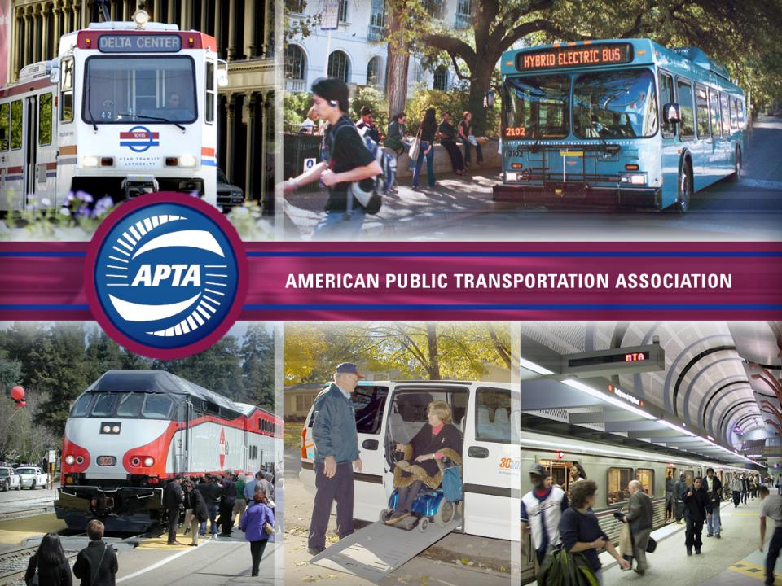

Slide 2
Alamys General Assembly
Guadalajara, Mexico
The American Public Transportation Association: Advancing Public Transportation in North America
James LaRusch
Chief Counsel and Vice President – Corporate Affairs
American Public Transportation Association
22 November 2011

Slide 3
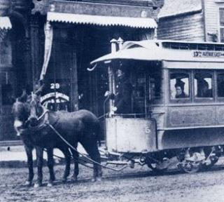
Who Are We?
Principal public transportation trade organization, with more than 1,500 transit, business, and other members in the United States, Canada, and worldwide.
Non-profit: 501(c)6.
Began in 1882—the era of horse-drawn street railway cars.
90% of transit riders travel on APTA member systems.

Slide 4
Who Are Our Members?

Slide 5
APTA Stakeholders
Federal government
Related transportation organizations
Environmental groups
Think tanks
State, local and grass roots
Academia and research
Technical/ Standards bodies
Media

Slide 6
Vision
APTA’s Vision and Mission
Be the leading force in advancing public transportation
Mission
To strengthen and improve public transportation, APTA serves and leads its diverse membership through advocacy, innovation, and information sharing

Slide 7
APTA’s Strategic Goals
Five Strategic Goals
Economic Sustainability
Environmental Sustainability
Safe And Reliable Mobility Systems
A Quality Workforce
Public Transportation: Essential Value To All

Slide 8
How APTA Defines
Public Transportation
Buses, heavy rail, commuter rail, light rail, streetcars, ferryboats, paratransit, vanpools
Scale of operations
  Large Urban (Rail, Bus, Paratransit)
  Small to Medium Urban (Bus, streetcars, light rail)
  Rural (Demand response, limited fixed-route service)
Typically local/regional delivery with local, state and federal funds

Slide 9
Public Transportation in the U.S.
35 million boardings every weekday.
10.2 billion annual boardings in 2010.
Approximately 7,700 transit providers in U.S., but 70% of usage on top 30 systems.
53% of trips on bus; 42% taken on Rail.
46% of U.S. households have no access.
$55 billion / yr. industry; directly employs 400,000 and supports 1.9 million jobs.

Slide 10
Trends Point to an Expanding Role
Population Growth
Urbanization
Social & Demographic
Economic
Energy & Environment
Household & Affordability
Public Choice

Slide 11
Public Transit Use Growing Faster Than Highway Use (1995 – 2009)
(15%) (21%) (31%)

Slide 12
Significant Expansion Nationally
(# of rail systems)

Slide 13
Challenges…But Also Opportunities
Meeting the Growth in Demand with Limited Funding
Workforce Development
Consensus within APTA

Slide 14
Sources of Transit Funding
Federal
State
Local – sales taxes and others
Directly Generated
  Fares
  Agency taxes
  Other (parking, advertising, etc.)

Slide 15
2008 Industry Revenue Sources –
$55 Billion
2008 Capital Funding - $17.4 Billion
2008 Operating Funds- $38.0 Billion

Slide 16
Sources of State/Local Funding Assistance
Sales Taxes
Property Taxes
Motor Fuel
Vehicle Fees
Car Rental / Leases
Room/Occupancy
Impact Fees
Realty Transfer
Naming Rights, etc.
Assessment Districts
Parking Fees
Tolls / Road Pricing
Employer/ Payroll/ Earnings/ Personal Income / Wage
Corporate Income
Utility Fees
Corporate Franchise Taxes

Slide 17
Public Private Partnerships
FTA support via Public Private Partnership Pilot Program
US Department of Transportation cooperation with Housing & Urban Development and Environmental Protection to promote livability

Slide 18
Denver Eagle P3 Project
Includes East Rail Line, Gold Line, Commuter Rail Maintenance Facility and a portion of Northwest Rail Line (to south Westminster)
Projects Funding - $2.1 billion
- $1.03 billion in federal funds (largest FFGA under Obama )
- $486 million in private equity
- $500 million in local funds
- Pursuit of $280 million TIFIA loan in process

Slide 19
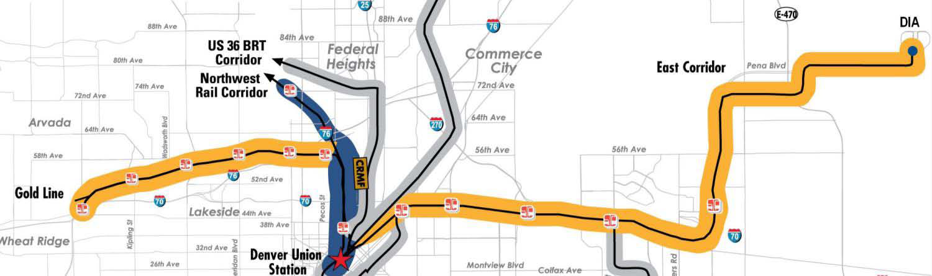
Denver Eagle P3
First full transit P3 in the United States (broader than earlier efforts in New Jersey and Virginia)
Leverages a Local Revenue stream (sales tax)
Project is part of FTA’s Public-Private-Partnership-Pilot Program (Penta P)
DBFOM – design-build-finance-operate-maintain

Slide 20

Advocacy
Promote greater investment by Congress in public transportation and high speed rail
Foster industry consensus on legislative issues affecting public transportation & intercity passenger rail
Develop pro-transit policies
Garner public support for our industry
    Research, Communications and Advocacy Program:

Slide 21
Workforce Development
Social media campaign
Internships and mentoring
Nationwide transportation career day
Youth summit
Research to support transit-specific engineering studies
Scholarships, Leadership APTA, partnerships with educational organizations (e.g., Eno Foundation)

Slide 22
Consensus
Governance model includes all constituencies
  Business members of all sizes represented on board
  Large, small, and medium size agencies on board
  Committee chairs as board members
All substantive issues vetted openly among all members to ensure ‘buy-in’

Slide 23
Information Sharing & Networking
  Conferences
Annual
EXPO
Rail
Legislative
Bus and Paratransit
Specialized workshops
Rail Rodeo and Bus Roadeo
Webinars
  My APTA
Online Forums
Membership Directory
Committee Lists
Industry Recognition
  Bus and Rail Rodeo
  AdWheel
  Customer Service Challenge
  Publications
Passenger Transport
Passenger Transport Express
Public Transportation Fact Book
Brochures
Studies, white papers
International Network
  Alamys
  ANTP
  Asstra
  CUTA
  CUPTA
  UIC
  UITP

Slide 24
¡Gracias Alamys! jlarusch@apta.com

Slide 25
