Slide 1
Sustainable Urban Transport Financing from the Sidewalk to the Subway Capital, Operations, and Maintenance Financing
Arturo Ardila-Gomez,
Adriana Ortegón-Sanchez
World Bank

Slide 2
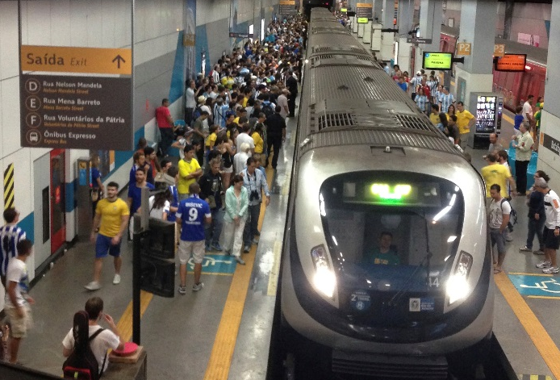
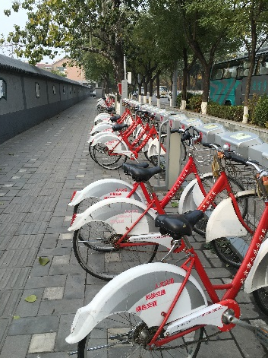
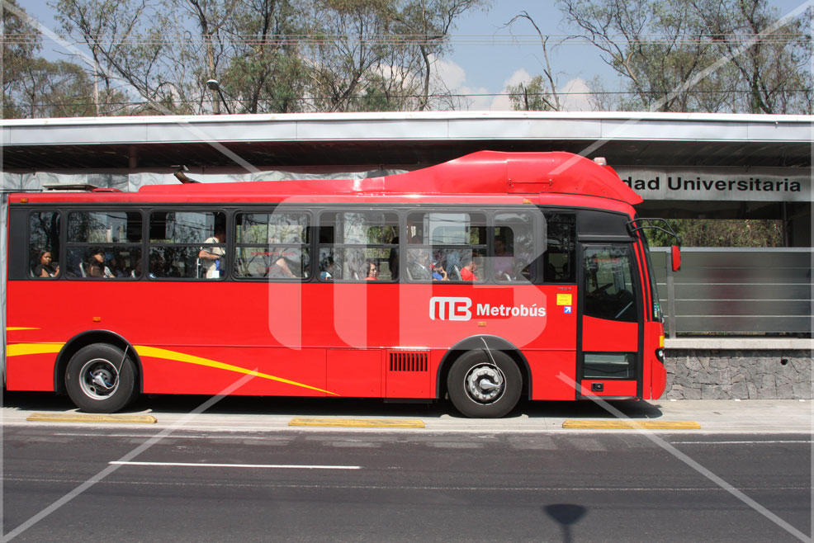
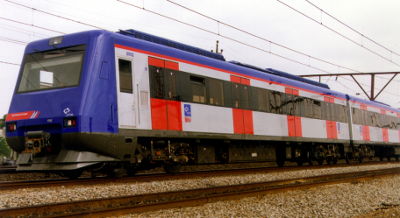
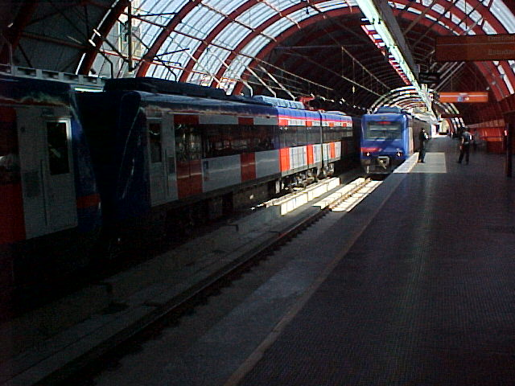

Slide 3
Financing needs: an approximation
Notes:
The needs are very large:Stylish model for 3 city sizes

Slide 4
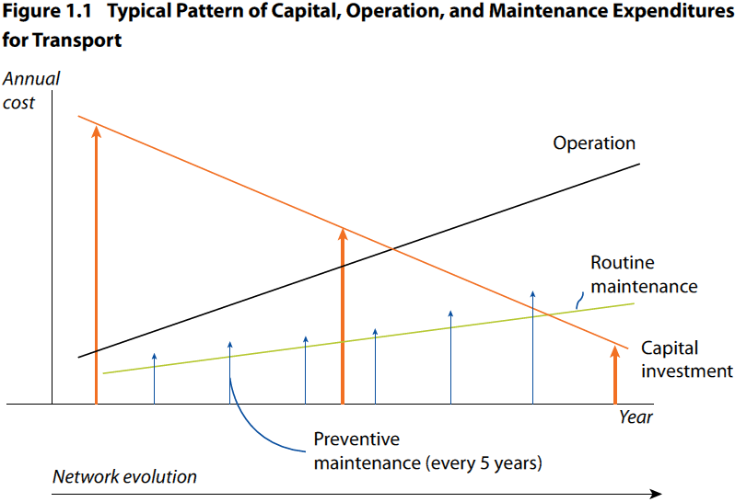
Financing needs
Notes:
The needs are very large:Stylish model for 3 city sizes
Allocated resources don’t cover total investment needs
Increasing urbanization and motorization rates can cause urban sprawl, further underfinancing and transport system unsustainability

Slide 5
Financing needs: an approximation

Slide 6
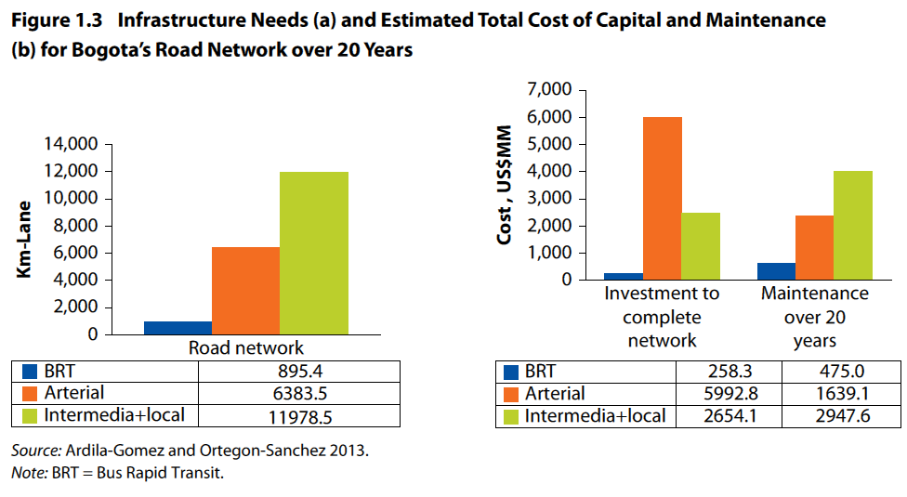
Financing needs: an example
Updated for network conditions and planned works up to 2010

Slide 7
The underfunding trap

Slide 8
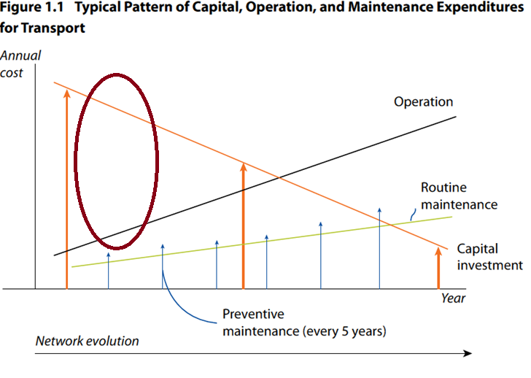
The underfunding trap
Notes:
The needs are very large:Stylish model for 3 city sizes
Allocated resources don’t cover total investment needs
Increasing urbanization and motorization rates can cause urban sprawl, further underfinancing and transport system unsustainability

Slide 9
Underfunding Trap: structural causes
LOW REVENUES DUE TO INEFFICIENT PRICING AND ECONOMIC DISTORTIONS that creates unbalance in favor of unsustainable modes
PERIODICITY MISMATCH between Revenue and Expenditure
INSTITUTIONAL COMPLEXITY: diverse levels (global, national, local) and sectors (public, private)
IMBALANCE IN INVESTMENT RESPONSIBILITIES AND FINANCIAL CAPACITY at the city level
LOW INVESTMENT causes construction and maintenance lag vicious cycle and deterioration

Slide 10
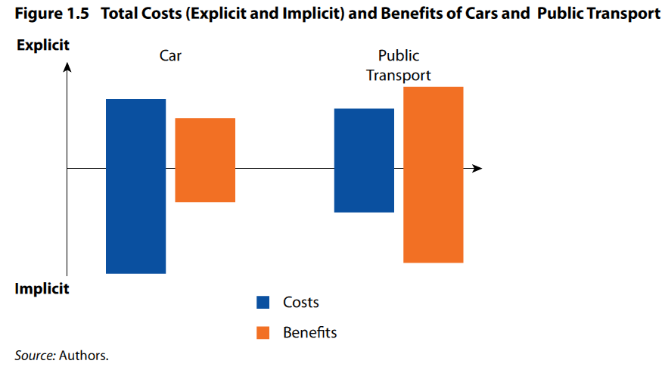
Low revenue - Implicit subsidies
Notes:
Financing gap further widened by the implicit subsidies for the use of private cars, which represent only a minority of trips but contribute huge costs

Slide 11
Low revenue - Implicit subsidies
PUBLIC TRANSPORT
Pocket costs
Explicit Subsidies
Pocket costs
Implicit Subsidies
Political Support
PRIVATE CARS
Stigma
Status
Notes:
Financing gap further widened by the implicit subsidies for the use of private cars, which represent only a minority of trips but contribute huge costs

Slide 12
Analytical framework to assess and design urban transport financing
The framework addresses the following elements:
Economic distortions and institutional complexity through application of the “Who Benefits Pays” principle based on the identification of beneficiaries (general public or direct and indirect beneficiaries)
The need for wiser investments, which can reduce the financing gap in the long term

Slide 13
Analytical framework to assess and design urban transport financing
Match periodicity of revenue and expenditures, specifically for capital, operation, and maintenance expenses.

Slide 14
Escaping the underfunding trap
WISE INVESTMENT
Benefits for the majority (short and long term)
Account for impact in urban growth
Create social, environmental and economic benefits
INNOVATIVE FINANCING INSTRUMENTS
Demand Management/
Behavior change potential
Increase Revenue Capacity
Correct Distortions, Internalize costs
A comprehensive multi-level financial strategy that corrects structural causes from revenue and expenditure side

Slide 15
Analytical framework to assess and design urban transport financing
Standardized Assessment of 24 urban transport financing instruments with respect to
FINANCIAL SUSTAINABILITY (Innovative financing)
stability, political acceptance, and administrative ease of instrument implementation
TRANSPORT SUSTAINABILITY (Wise investment)
economic efficiency, social equity, and environmental impact

Slide 16
Financing Instruments Assessment: General Beneficiaries
Upfront
Recurrent
Both
High
Average
Low
Notes:
From the sustainable transport perspective the majority of instruments perform well in terms of accounting for environmental impacts.
In terms of the financial sustainability public acceptance is the attribute with most positive performance across instruments.

Slide 17
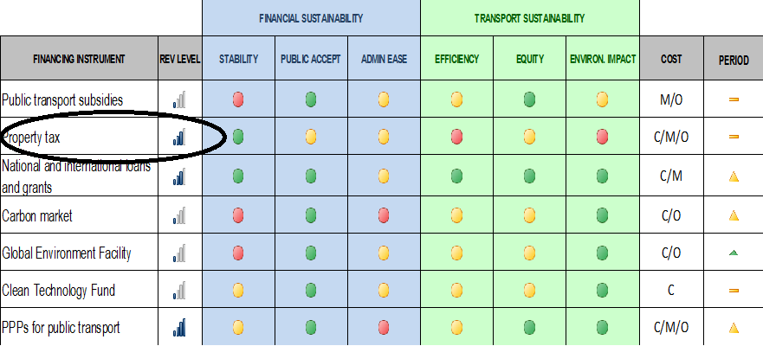
Financing Instruments Assessment: General Beneficiaries
Upfront
Recurrent
Both
High
Average
Low
Notes:
From the sustainable transport perspective the majority of instruments perform well in terms of accounting for environmental impacts.
In terms of the financial sustainability public acceptance is the attribute with most positive performance across instruments.

Slide 18

Financing Instruments Assessment: Direct Beneficiaries
High
Average
Low
Notes:
These instruments are the ones that best represent the “who benefits pay” principle, consequently they perform very well in terms of achieving sustainable transport attributes
From the financial sustainability perspective, the instruments do not perform very well in terms of public acceptance. This is due to the reluctance both from the authority and the users to charge or pay for something that is perceived as free

Slide 19
Financing Instruments Assessment: Indirect Beneficiaries
High
Average
Low
Notes:
Finalmente, fuentes de financiamiento que reflejan beneficios indirectos, por ejemplo la plusvalía urbana, tienen un alto costo de transacción y su uso se adapta más a proyectos específicos que permitan ligar el beneficio y el cobro.
These instruments have an average performance in both Financial and Transport sustainability . However, some have very high revenue levels.
The weakest performance for Financial sustainability is related with Administration Ease which is associated with the high transaction cost given the multiple agents involved.

Slide 20
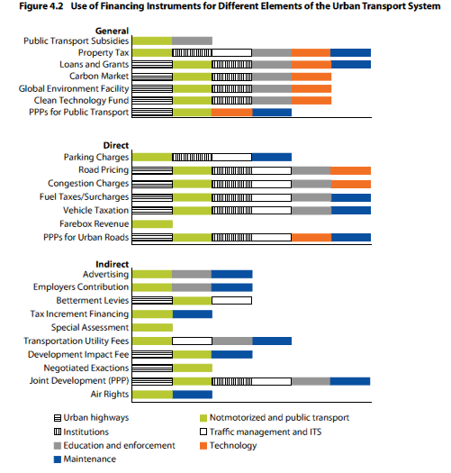
Possible uses for the Financing Instruments General Beneficiaries

Slide 21
Possible uses for the Financing Instruments Direct Beneficiaries

Slide 22
Possible uses for the Financing Instruments Indirect Beneficiaries

Slide 23
Conclusions
Link urban transport planning and operations with urban planning.
Combine revenue sources to ensure financial sustainability using the Who Benefits Pays principle.
Consider the effect of instruments on transport demand. Not only the choice of transport investment but also the choice of instrument will affect the use and demand for transport systems in a city: Wise Investments

Slide 24
Conclusions
Ensure appropriate use of public subsidies. Subsidies should be coupled with regulations, such as contract and quality performance indicators, to guarantee high-quality sustainable public transport.
Allow cities financial autonomy and capacity. A property tax can be an important tool as it is a cost-effective way to raise critical revenue to cover the capital, maintenance, and operation costs for elements of the transport system, such as, mass transit, and neighbourhood roads and sidewalks.

Slide 25
Conclusions
Allow a role for national governments and international funding in light of climate change and the need to invest in projects that contribute to the global benefit of reducing emissions from the transport sector.
Understand the need for a gradual introduction of user charges.

Slide 26
Conclusions
Consider land value–based financing instruments but be aware of transaction cost and political work behind.
The framework guides the assessment of revenue options and helps cities use instruments strategically to not only fund needed transport investment but also actually achieve their larger sustainable urban transport and development objectives.

Slide 27
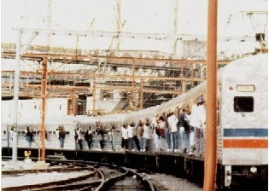
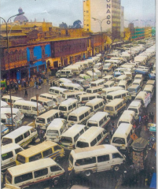
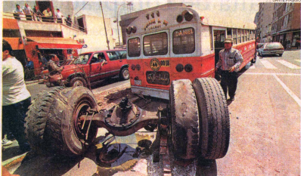
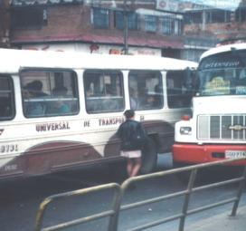
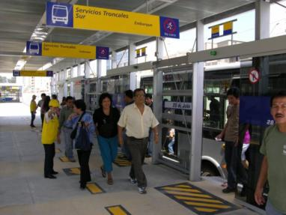

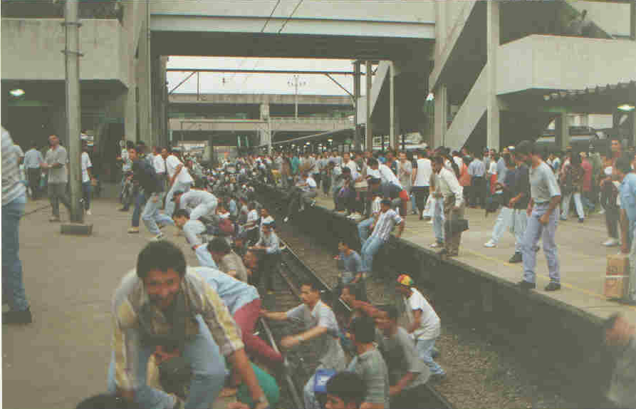

Slide 28
Epilogue
PUBLIC TRANSPORT
Pocket costs
Subsidies
Pocket costs
CARS
Political support
Status/Pride
Status/Pride
User charges

Slide 29
Download the book here
Sustainable Urban Transport Financing from the Sidewalk to the Subway
or here:
https://openknowledge.worldbank.org/handle/10986/23521

Slide 30
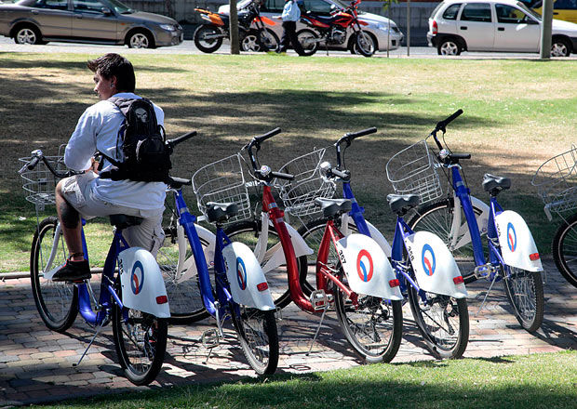
Thank you

